Slide 1

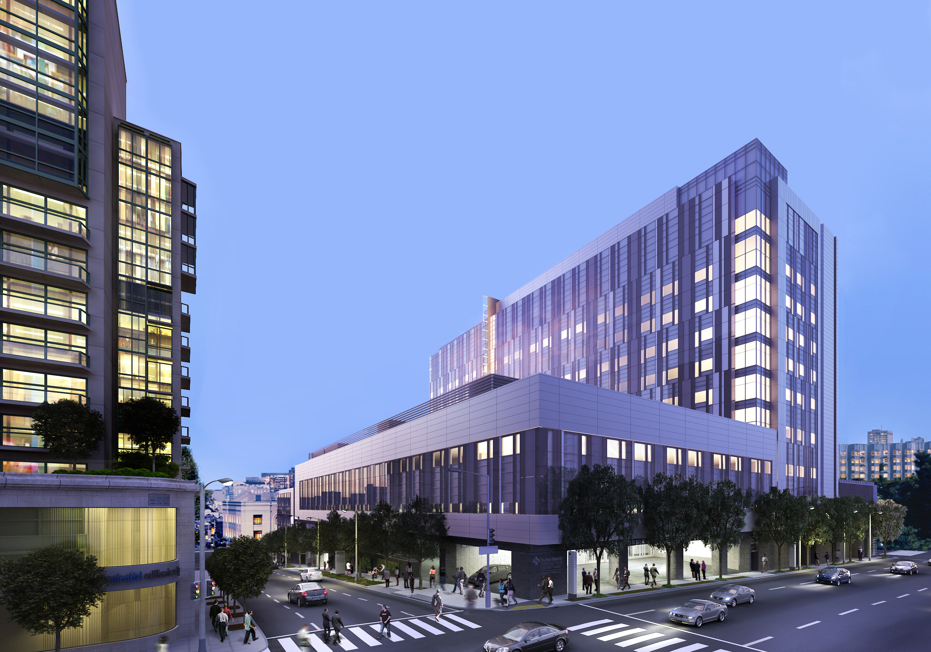
Van Ness Campus
General Orientation

Slide 2
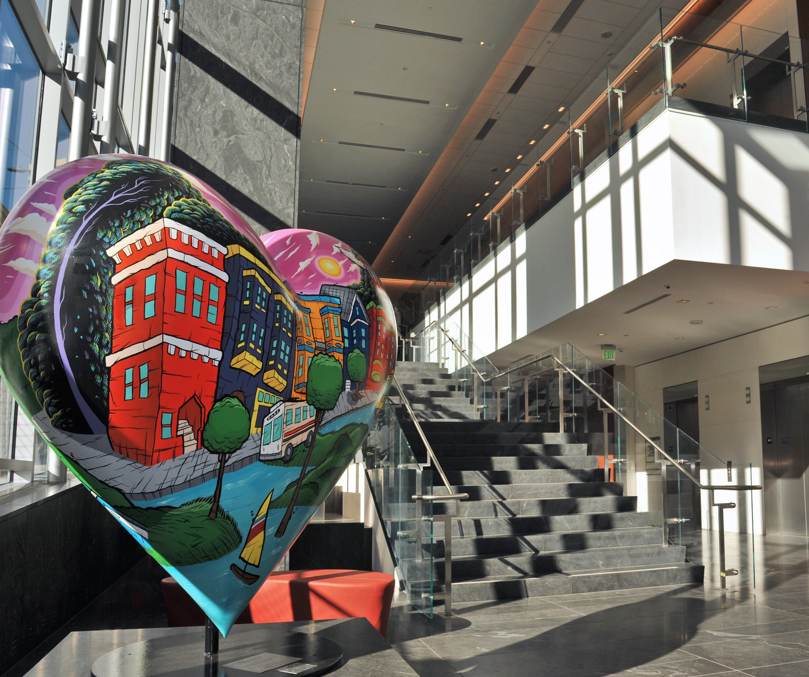
Welcome
Retaining the “heart” of what we do
Balancing safety, comfort and sustainability
Notes:
Van Ness Hospital is a 11-story, 274 bed, full-service medical center with an emergency department and supporting services including imaging services, and laboratory. The building is thoughtfully designed to enhance patient comfort, be environmentally conscience, be seismically safe, and support current and future technologies.

Slide 3

Activities for the Day
Overview and General Orientation presentation
Facility tour
Break
Sutter Safe Care (2 CEUs)
Cisco phone training
New badges
Staff Appreciation gifts
45 minutes
45 minutes
15 minutes
2 hours
15 minutes
Notes:
Retaining the “heart” of what we do
The MBC opening is the culmination of years of hard work, commitment and anticipation
We are continuing legacy of being the neighborhood hospital in the Mission District and retain the “heart” that has made St. Luke’s special for patients, staff, physicians and volunteers
Balancing safety, comfort and sustainability
The modernized campus is seismically safe and certified as Leadership in Energy and Environmental Design (LEED), a globally-recognized symbol of sustainability.

Slide 4
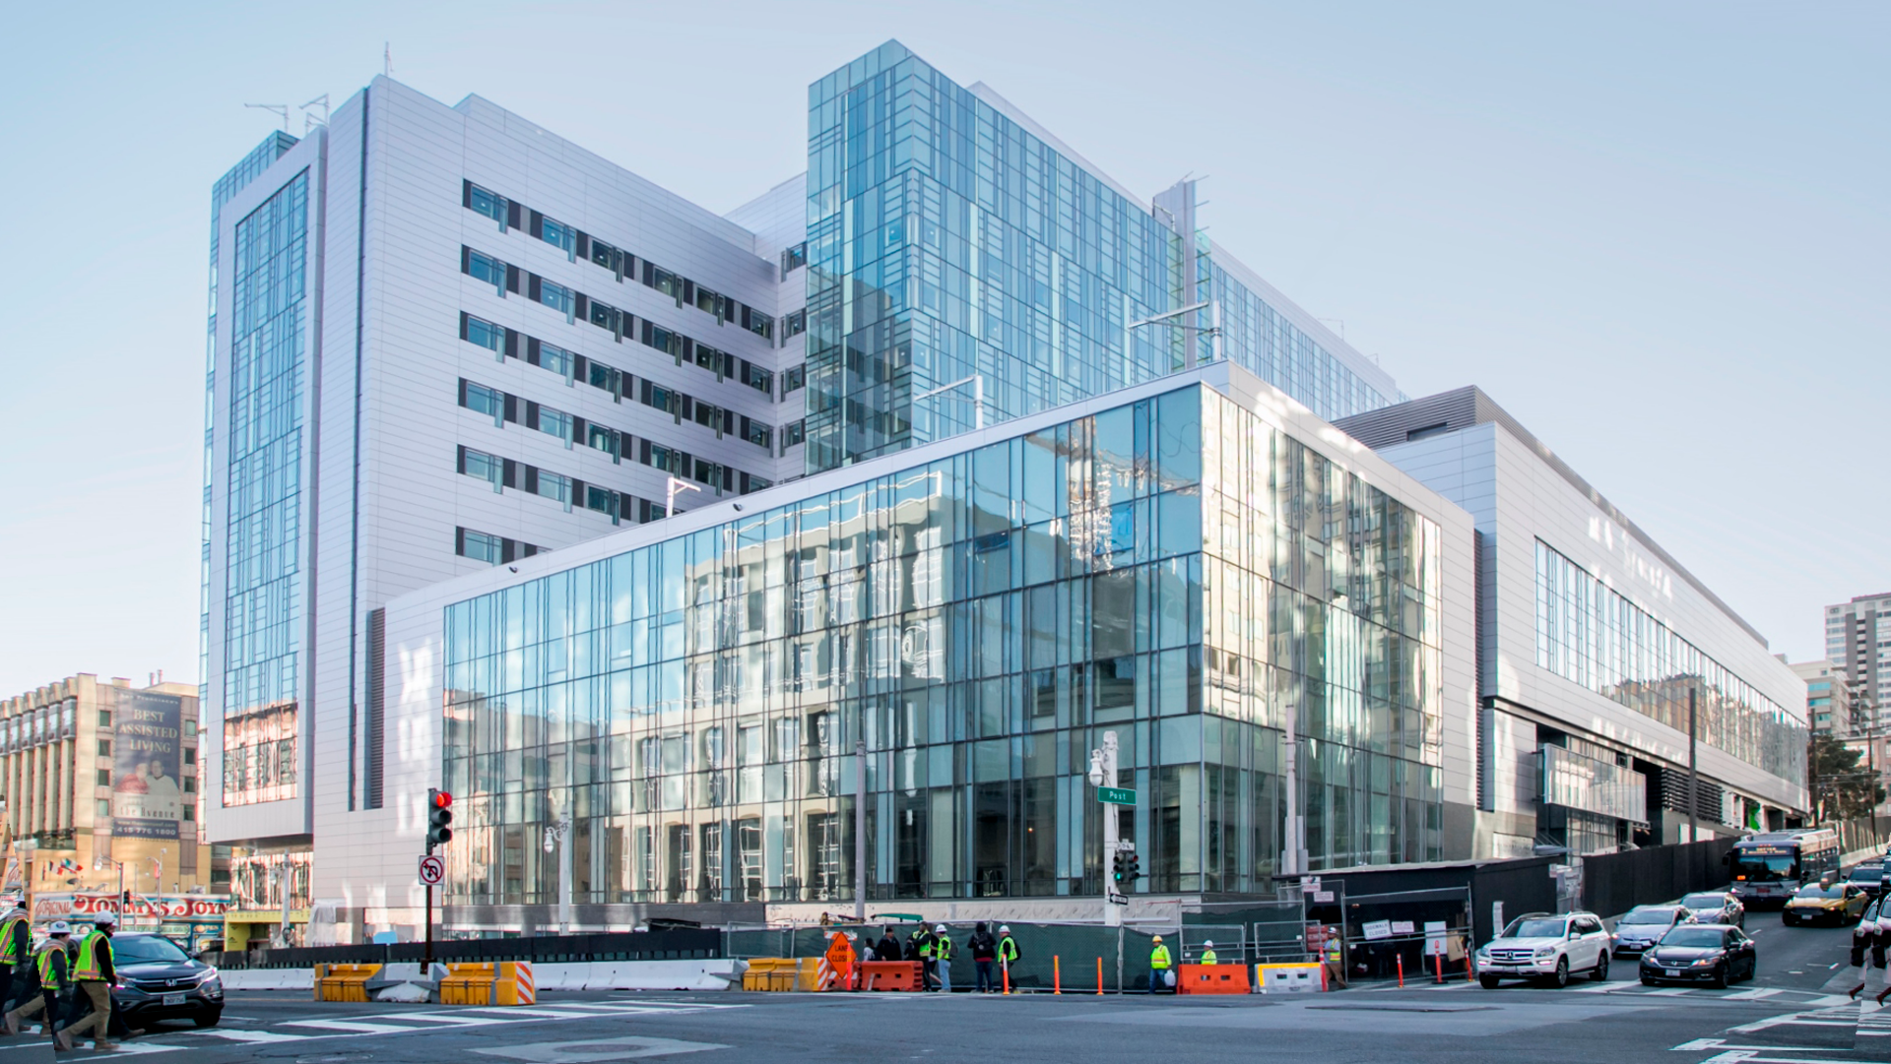
Knowing your Environment
Notes:
It is important to be able to navigate the new facility and understand how to work effectively in it. This section is an introduction to the new facility.

Slide 5
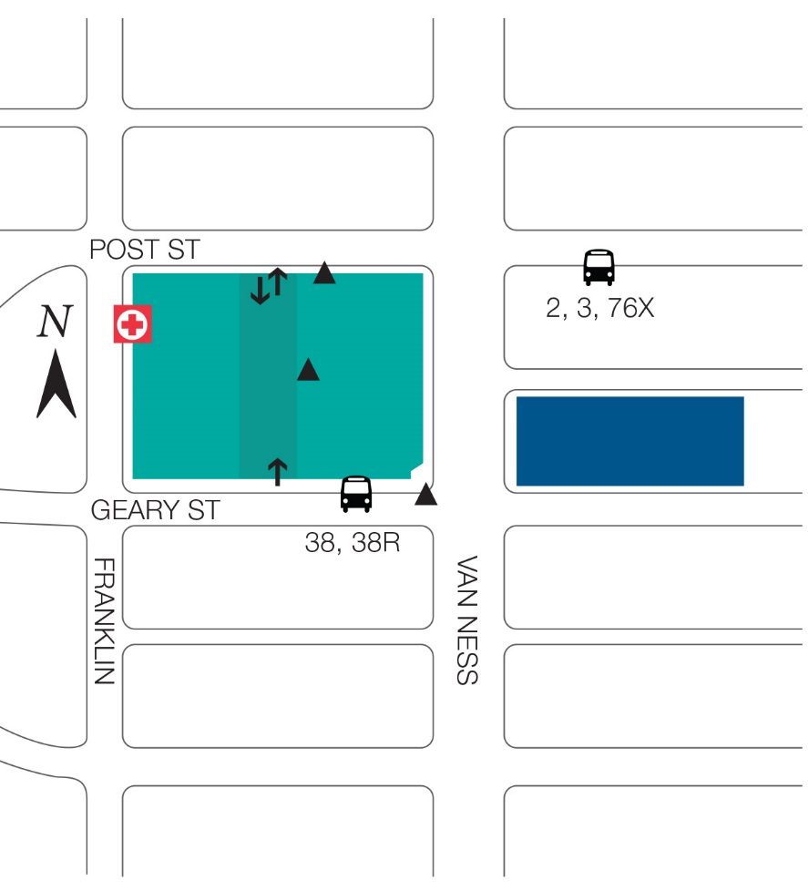
Hours of Operation
Van Ness Entrance (L1) | 7:00am–7:00pm Everyday | Badge after hours
Driveway (L2) | 5am–8pm Mon-Fri​ 7am–7pm Sat-Sun​ | Open every day
Post Street Stairs (L2) | 24 hours a day | Staff & Badge only
Post Street (L2) | 7am–7pm | Badge after hours
Geary Street (L2) | 24 hours a day | Staff & Badge only
Emergency | 24 hours a day | Open every day
Chuck Williams Café | 6:30am–6:30pm Mon–Fri 6:30am–2:30pm Sat–Sun | Closed after hours
Coffee Shop (L2) | 6:00am–6:00pm Mon–Fri 6:30am–2:30pm Sat–Sun | Closed after hours
Loading Dock Off Franklin Street | 5:00am–8:00pm Mon–Fri | Other hours by appointment
Mailroom (L1) Room No. 111A | 24 hours a day | Open every day Badge Required
Newborn Connections 1100 Van Ness | 10:00am–4:00pm Mon–Fri 10:00am–2:00pm Sat | Closed on Sunday
Walgreens Pharmacy 1301 Franklin Street | 9:00am–9:00pm Mon–Fri 9:00am–5:00pm Sat 10:00am–6pm Sun
CVS Pharmacy 1285 Sutter Street | 9:00am–7:00pm Mon–Fri 10:00am–5:00pm Sat–Sun
Walgreens Pharmacy | Coming Soon
Post St Entrance
Hospital
Medical Office Building
Geary St Entrance
Van Ness Entrance
Notes:
Teach an overview of
Where the campus is
Hours of operation
Enter / entrances
Amenities

Slide 6

Building Guidelines
Beautiful and tidy = Positive Environment
On stage / off stage concept
Refrain from moving furniture or equipment in the building
Refrain from hanging things on the wall (art and bulletin boards provided)
Only service animals allowed in building (no fish or pets)
Personal packages will no longer be accepted at the campus
Ordering food for delivery – Staff are responsible to come down to the 3rd floor security desk at the Emergency Department to pick up food
Notes:
Help us create a positive environment for our patients and visitors. Please remember that we are moving into a brand new hospital that we want to keep as beautiful and tidy as the day we move in.
Remember you are “on stage” in front of house areas which are the areas that patients and visitors will see
Please refrain from:
moving furniture or equipment in the building
hanging things on the wall (art and bulletin boards provided)
Bringing fish or pets of any kind to work, with the exception of service animals
Having personal packages delivered to campus
Expecting food delivery orders to be brought to unit—Staff are responsible to come down to the second floor Security Desk to pick up food.

Slide 7
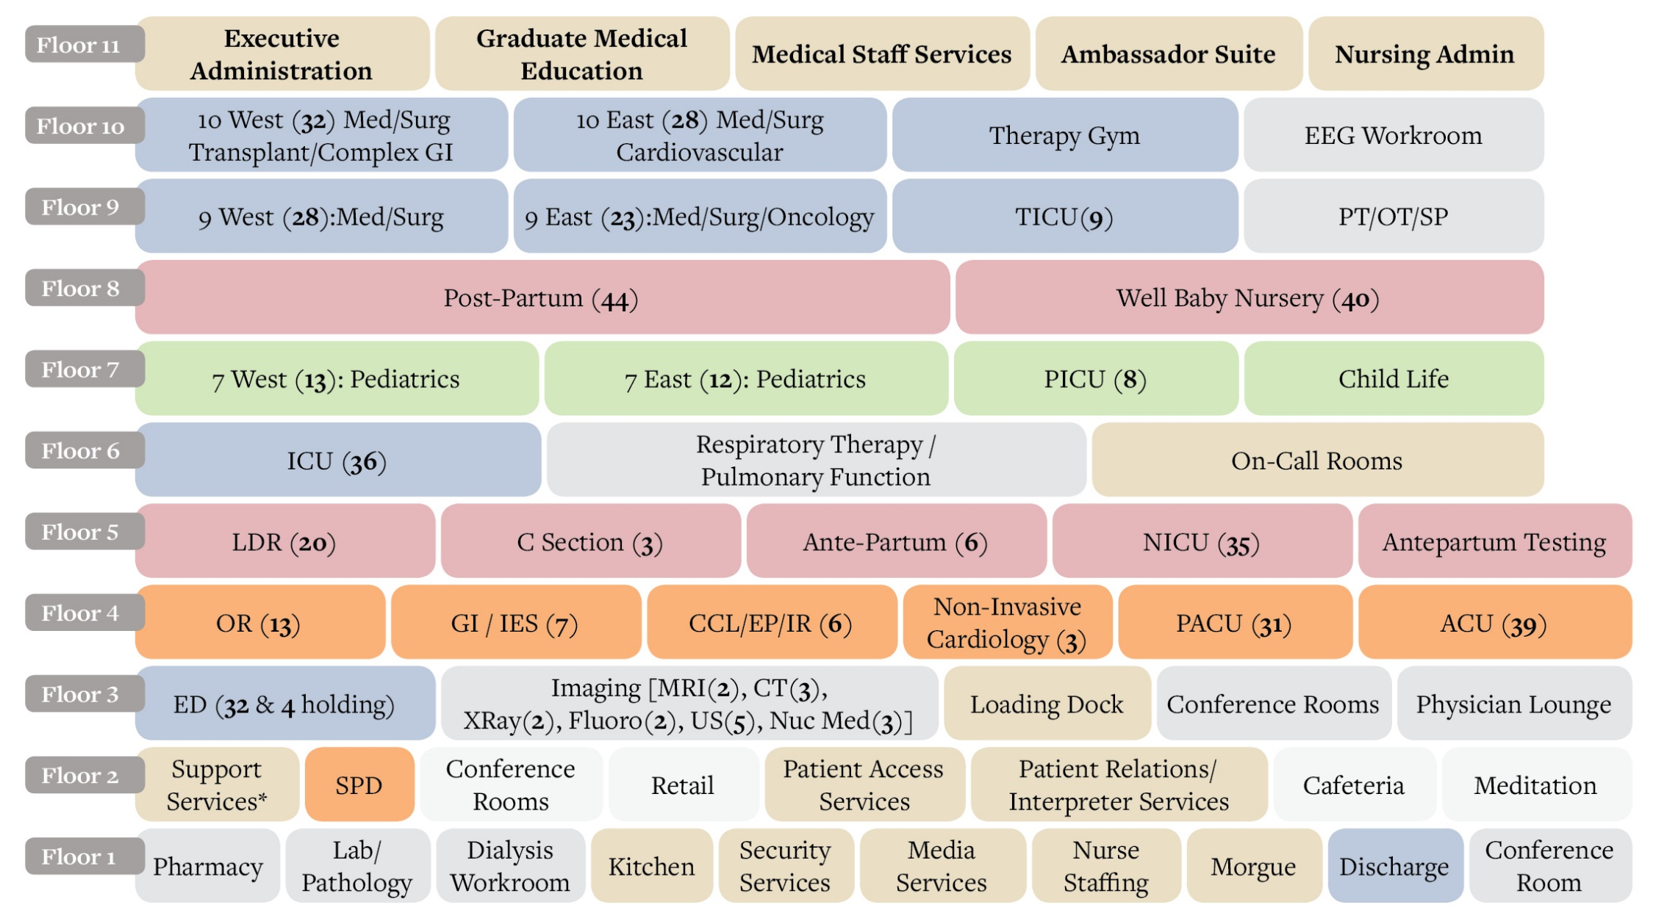
Notes:
Teach an overview of
Where the campus is
Hours of operation
Enter / entrances
Amenities

Slide 9
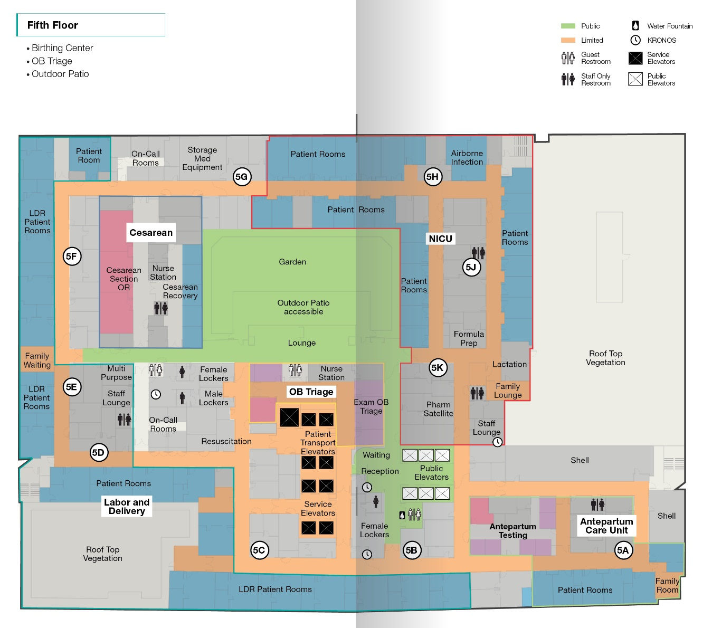
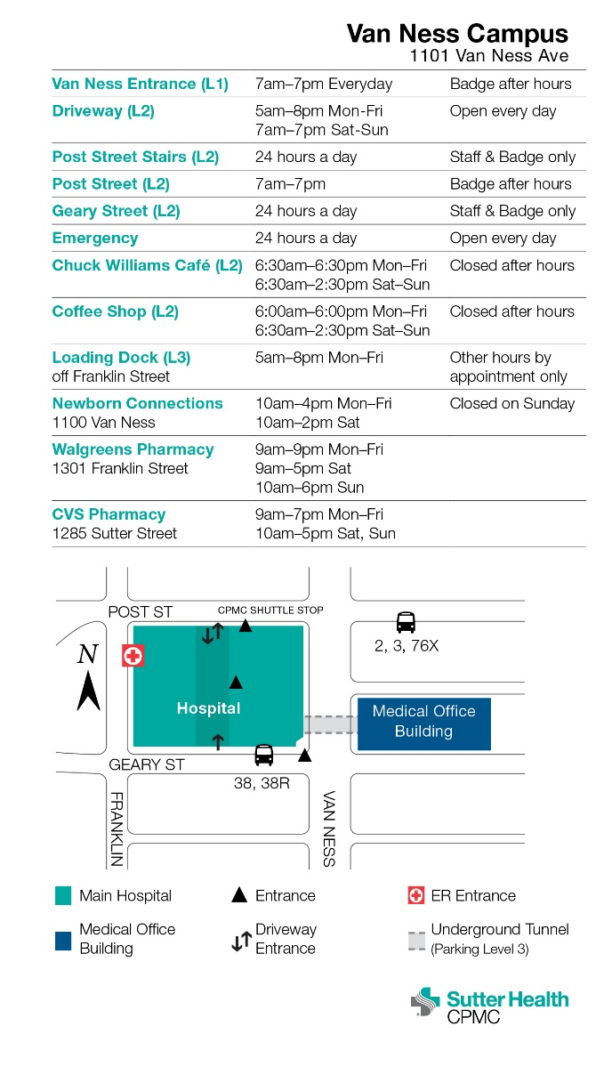
Using Your Pocket Guide
Quick Reference
Easy to Use
Easy to Carry
Available to all staff and physicians
Notes:
**Teach out how to use the guide**
The pocket guide is a tool for staff to easily navigate the new facility. The pocket guide will help you navigate the building as well have a quick reference to important facts such as hours of operation, entrances, and phone numbers.

Slide 10
Elevators
There are 25 elevators at Van Ness Campus
2 Red Shuttle Parking Garage elevators to Emergency Department (P3, P2, P1, and L3)
2 Green Shuttle Parking Garage elevators to Main Lobby (P3, P2, L1, L2)
6 public elevators
4 + 1 patient transport elevators
4 service elevators
3 SPD elevators
1 Freight
2 Kitchen

Slide 11
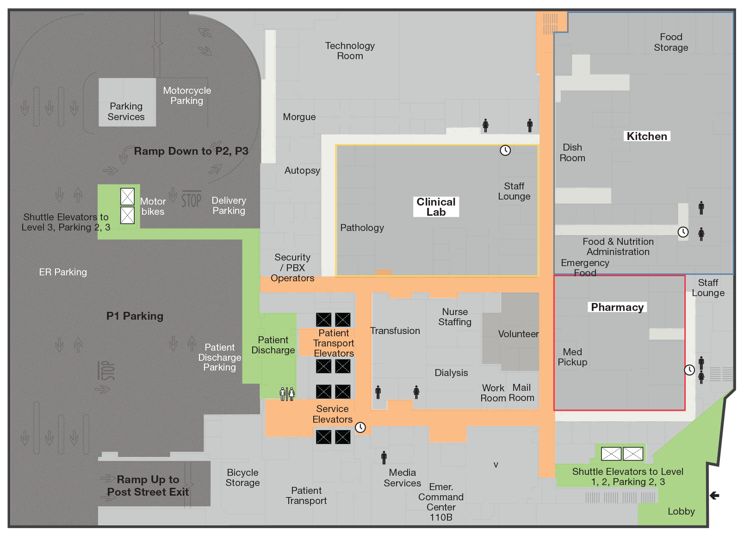
First Floor elevators
Notes:
**Teach out how to use the guide**
The pocket guide is a tool for staff to easily navigate the new facility. The pocket guide will help you navigate the building as well have a quick reference to important facts such as hours of operation, entrances, and phone numbers.

Slide 12
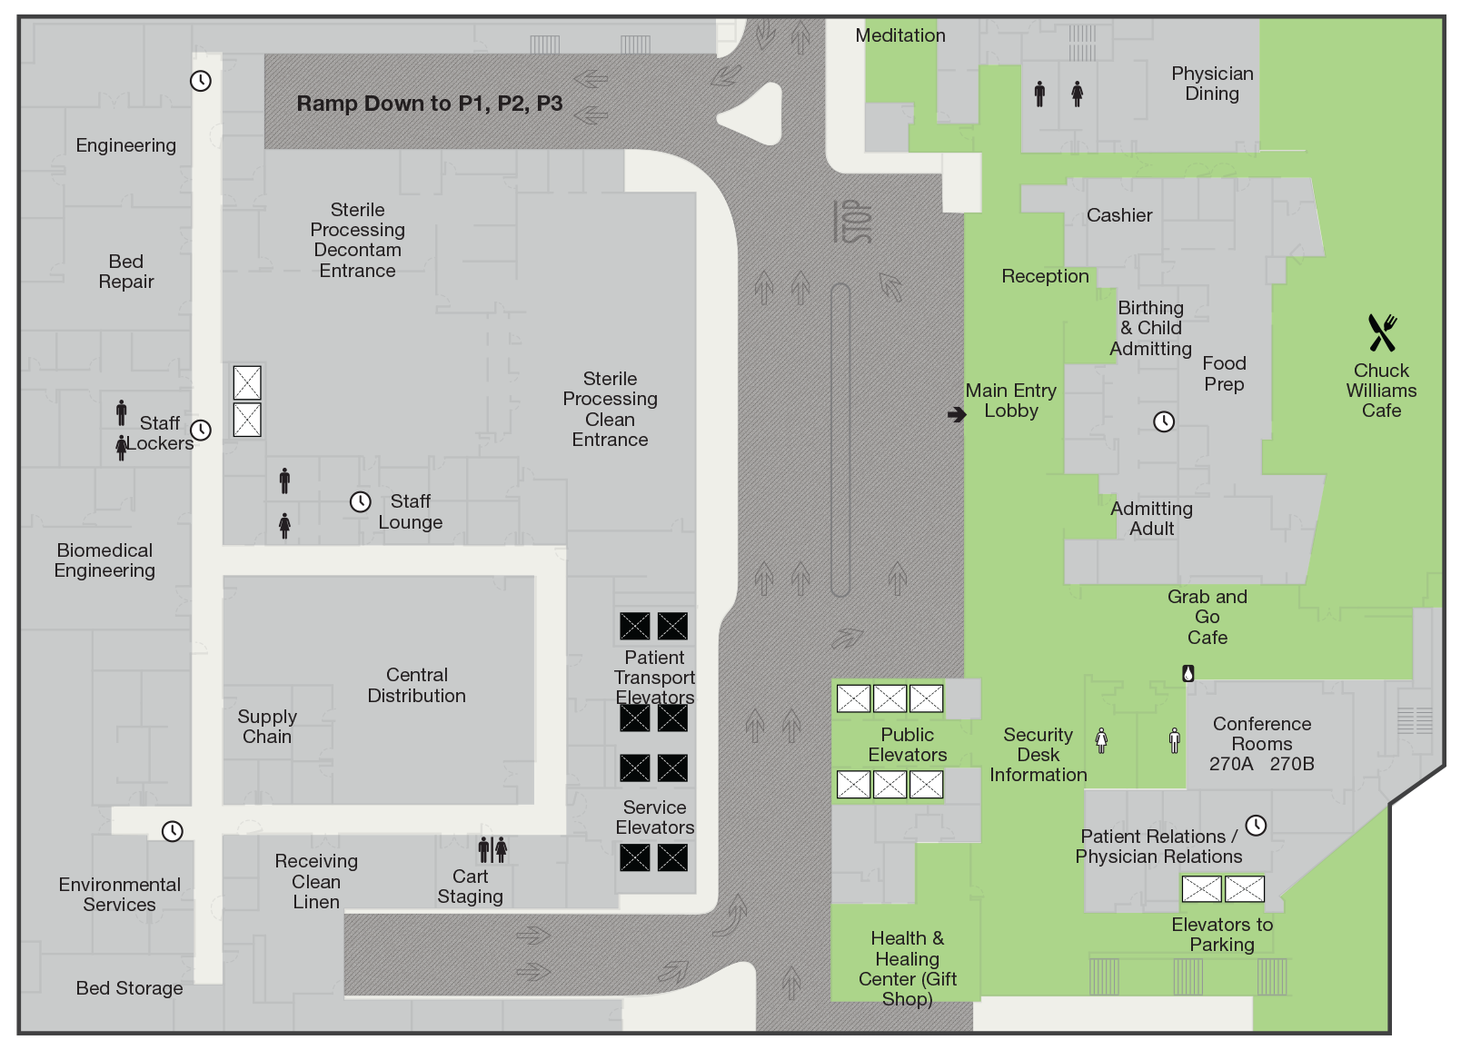
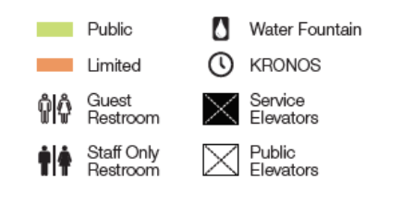
Second Floor elevators

Slide 13
Staff Lockers
Department Lockers | Location
Bicycle Lockers
Central Sterile | 2273, 2275
Clinical Lab | 1427, 1428
Emergency Department | 3374
Engineering | 2302, 2304
Environmental Service | 2251, 2253
Food Service/ Kitchen | 1530, 1632
ICU | 6053, 6055
Imaging | 3540, 3542
Interpreters | 2856
Invasive Services/ Surgery | 4202, 4204
Labor & Delivery | 5030, 5172, 5174
Med Surg/ Acute Care | 9063, 10063
Pathology | 1322
Patient Transport | 1206
Pediatrics | 7063
Pharmacy | 1629
Postpartum | 8300A
PT/OT | 9067
Residents | C610A
Respiratory Therapy | 6210B
Security | 1303B
Volunteers | 1651
Lockers are available for staff use in department areas (see chart).
All lockers will be day use only, unless otherwise designated by management.
Lockers accept padlocks and are two or three high.
Department managers are responsible for handling locker buddy assignments and distribution.

Slide 14
Staff Lockers
Department Lockers | Location
Bicycle Lockers
Central Sterile | 2273, 2275
Clinical Lab | 1427, 1428
Emergency Department | 3374
Engineering | 2302, 2304
Environmental Service | 2251, 2253
Food Service/ Kitchen | 1530, 1632
ICU | 6053, 6055
Imaging | 3540, 3542
Interpreters | 2856
Invasive Services/ Surgery | 4202, 4204
Labor & Delivery | 5030, 5172, 5174
Med Surg/ Acute Care | 9063, 10063
Pathology | 1322
Patient Transport | 1206
Pediatrics | 7063
Pharmacy | 1629
Postpartum | 8300A
PT/OT | 9067
Residents | C610A
Respiratory Therapy | 6210B
Security | 1303B
Volunteers | 1651
Lockers are available for staff use in department areas (see chart).
All lockers will be day use only, unless otherwise designated by management.
Lockers accept padlocks and are two or three high.
Department managers are responsible for handling locker buddy assignments and distribution.

Slide 15
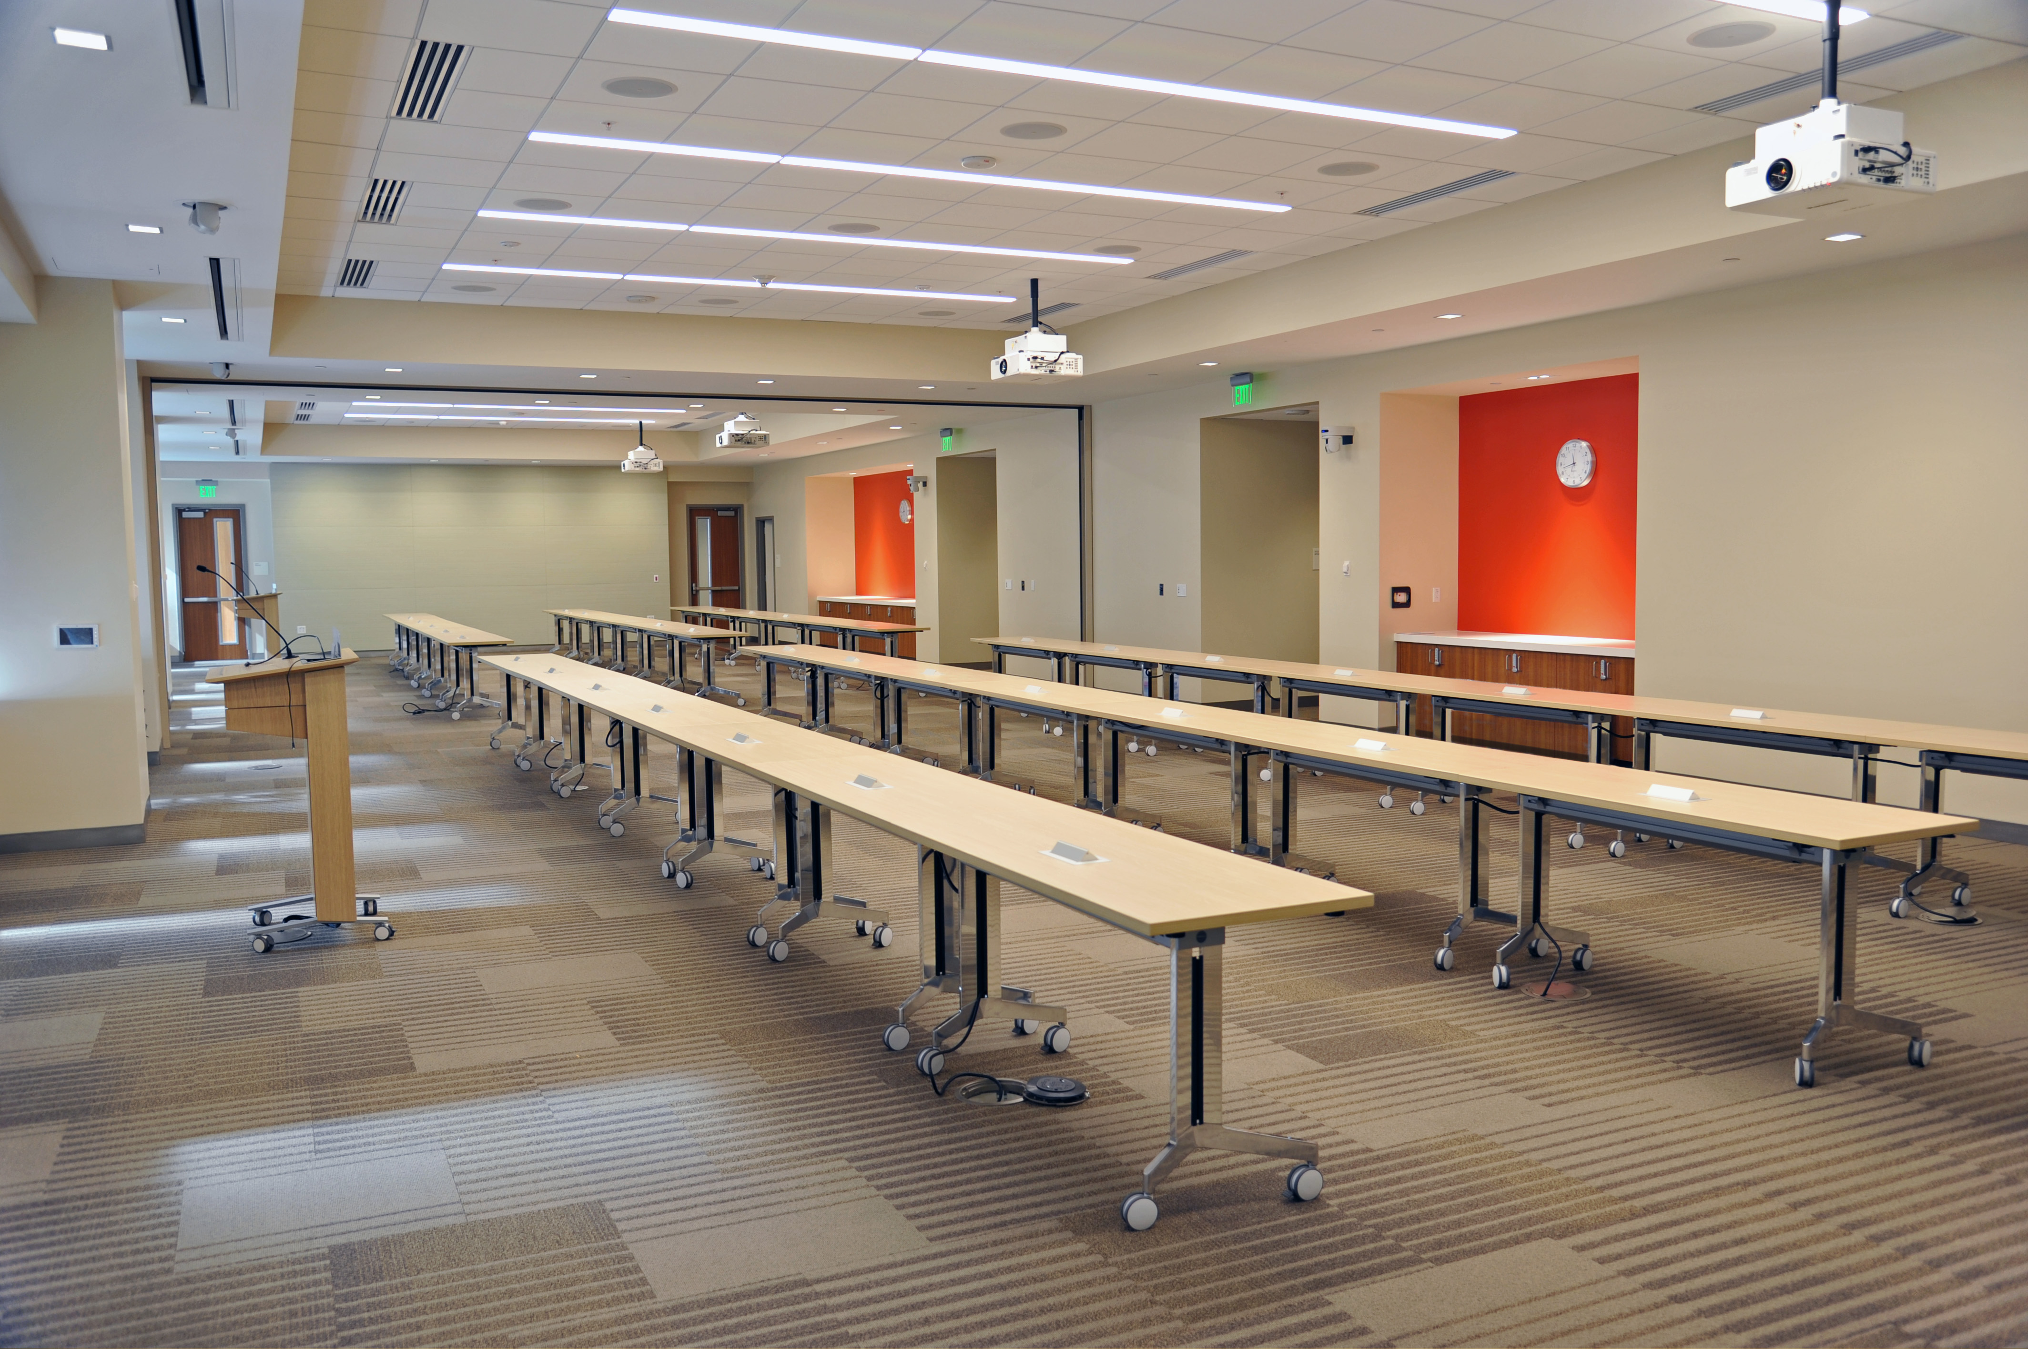
Shared Spaces
Multi-disciplinary Workrooms
Inter-disciplinary Workrooms
Consult Rooms
Family Rooms
Staff Lounges
Notes:
Van Ness is designed as a shared work space.
Multi-disciplinary workrooms are conference-style type rooms on patient care floors. These rooms accommodate ten people sitting around a rectangular conference table and are equipped with a large wall monitor and teleconferencing.
Inter-disciplinary workrooms are individual computer workstations in a shared workroom environment. Workstations are not to be “claimed” for any specific individual use. Practice shared workspace etiquette; keep the volume down, no eating and clean up after yourself.
Consult rooms are designed for providers to have private conversations with patient family member(s) and significant others. Rooms may be locked; requests keys from the charge nurse. Please clean the room after every use.
Family rooms are public areas for family members to sit and gather, outside the patient room.
Staff Lounges are for non-physician staff. Nursing staff is responsible for cleaning the coffee maker.

Slide 16
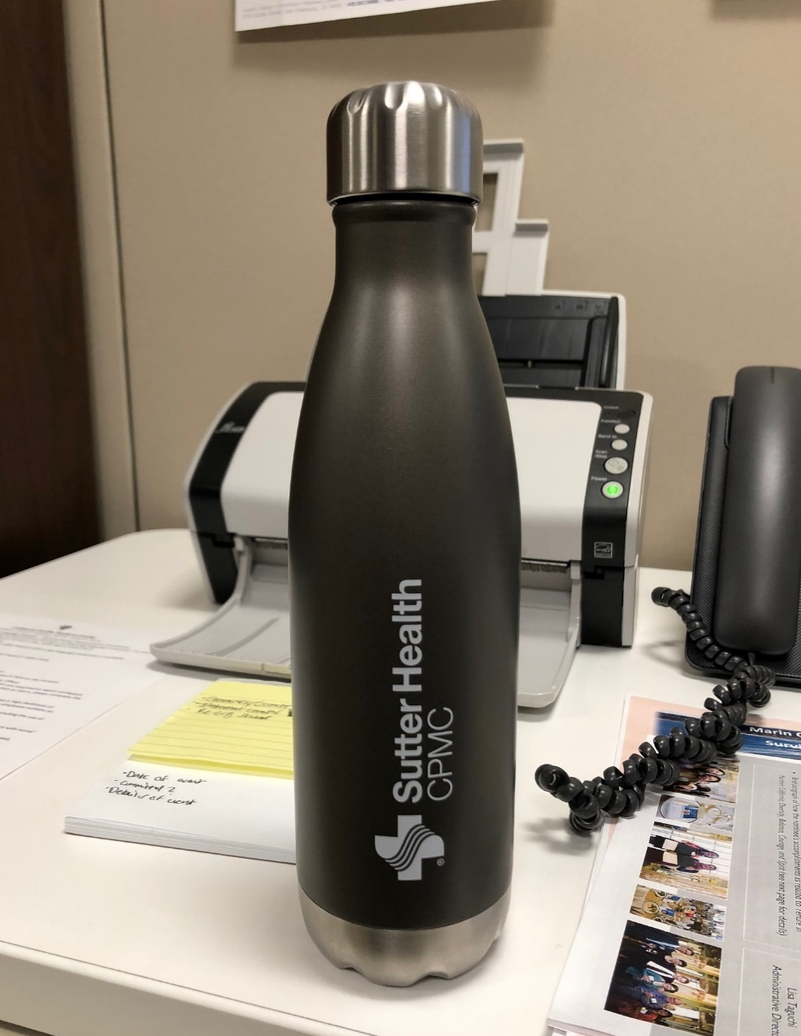
Water, Water Everywhere
Water fountains are available on each floor
There are plumbed coffee makers with hot water dispensers in several locations
Ice makers are available in patient nourishment rooms
Bottle filling locations:
Emergency Department
Cafeteria
Surgical Waiting Room
Notes:
VNC is a LEED certified building. To reduce the use of disposable bottles, water fountains are available on each floor near the elevators.

Slide 17
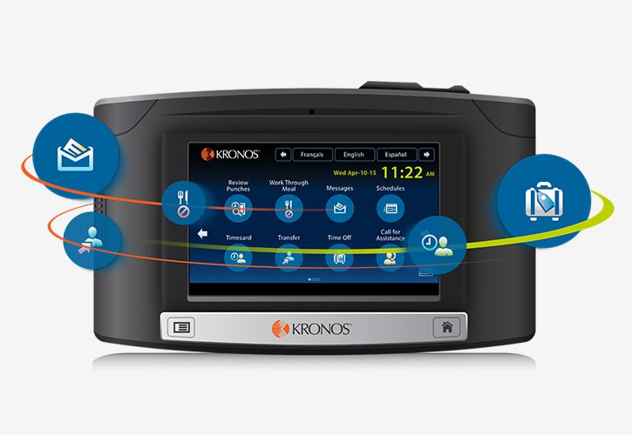
Kronos Time Clocks
New InTouch wall clocks are conveniently positioned near:
Elevator lobbies
Main corridors
Lab & Pharmacy
Some Staff Lounges
A Web App will also be available for some users

Slide 18
Quiz Time
Knowing Your Environment
How many floors does Van Ness Campus have?

Slide 19

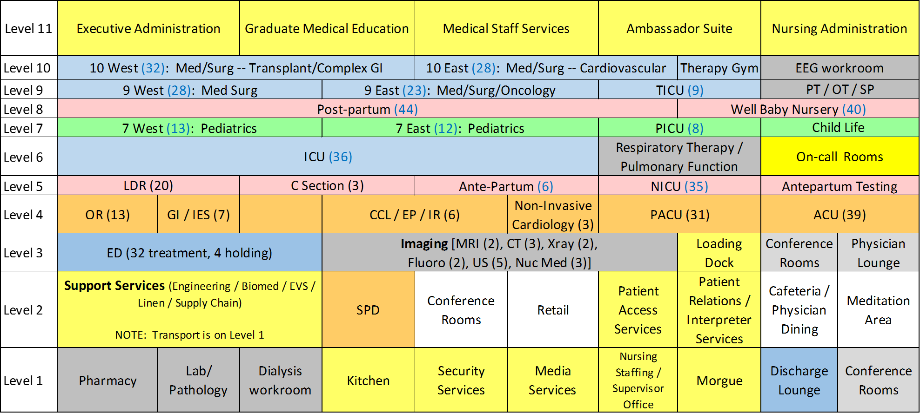
Quiz Time
Knowing Your Environment
How many floors does
Van Ness Campus have?
11 Floors!

Slide 20
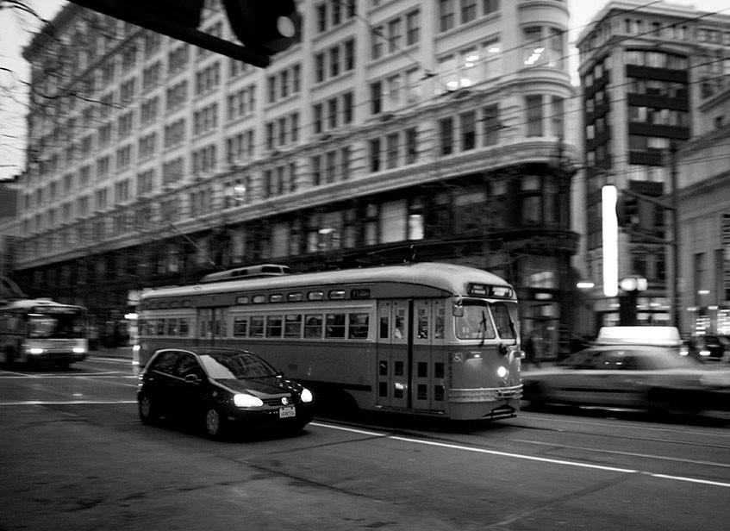
Transportation
Notes:
CPMC encourages visitors and staff to follow San Francisco’s Transit First policy and use alternative modes of transportation whenever possible. The Van Ness Campus is easily accessible by a combination of rail, bus, shuttle, ferry and/or bicycle.

Slide 21
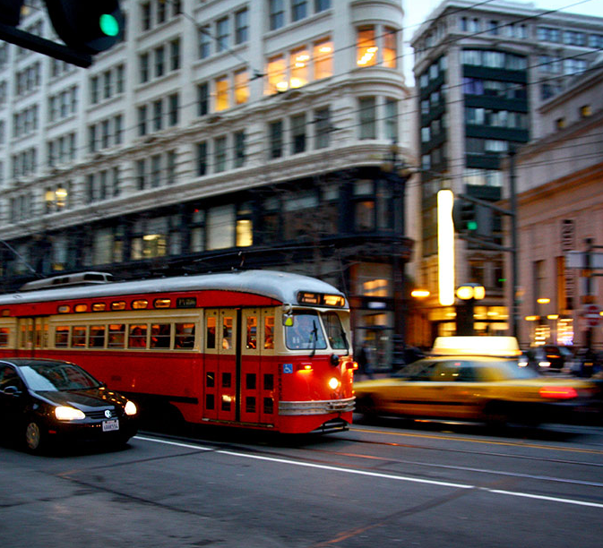
Public Transportation
Complimentary shuttle services to and from Civic Center BART station
Check out 511.org for a comprehensive list of transit options
Public transportation and shuttle timetables available at the Information Desk and kiosk for patients and visitors
Notes:
CPMC encourages visitors and staff to follow San Francisco’s Transit First policy and use alternative modes of transportation whenever possible. The Van Ness Campus is easily accessible by a combination of rail, bus, shuttle, ferry and/or bicycle. Visit 511.org for a comprehensive list of transit options to spare the air and keep our campuses safer for you and your families.
Patients and visitors may also obtain additional information on public transportation and shuttle timetables at the Information Desk. Staff and providers may visit our Intranet for additional public transportation and shuttle service information.

Slide 22
CPMC Shuttles and Routes
Shuttle service is available every 30 minutes, Monday through Friday, 6:00 a.m. to 6:00 p.m.
More specific information and pickup locations: cpmc.org/visiting/shuttle.html
CPMC Shuttle Routes
B | Civic Center BART to Van Ness Campus
D | Davies to Van Ness Campus
JG | Japantown Garage to Van Ness Campus
K | Kabuki Hotel to Van Ness Campus
MBC | Mission Bernal to Davies Campus
MBC24 | MBC to 24th St Mission BART
SAC | 1825 Sacramento to Civic Center BART

Slide 23
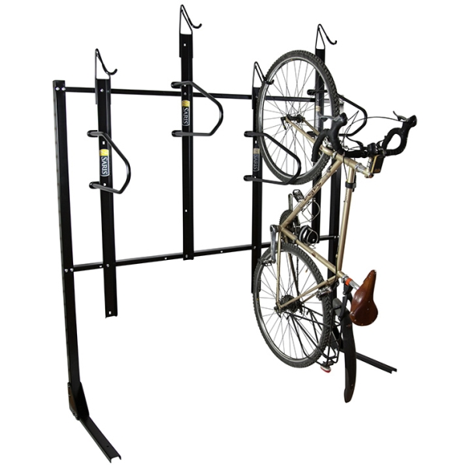
Bicycle Storage & Locker Space
First come, first served bicycle storage in P1
Badge reader access
Submit registration form in advance (request from parking office) to secure space and program badge
“Fix it” station located inside bicycle storage
Day lockers, bathrooms and showers are located in the bicycle storage room on P1

Slide 24
Quiz Time
Transportation
How much does the new bicycle storage at VNC cost employees?

Slide 25
Quiz Time
Transportation
How much does the new bicycle storage at VNC cost employees?
It’s FREE on a first-come, first-served basis

Slide 26
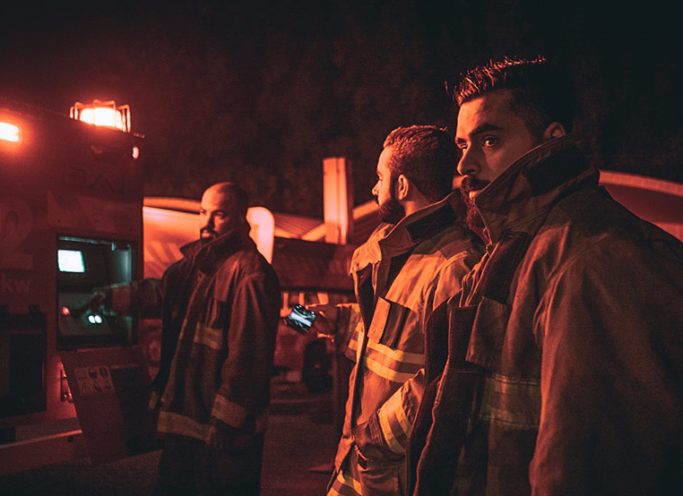
Safety
Notes:
We want all employees, patients and visitors to be safe in the new VNC facility. Important safety information is included in this section

Slide 27
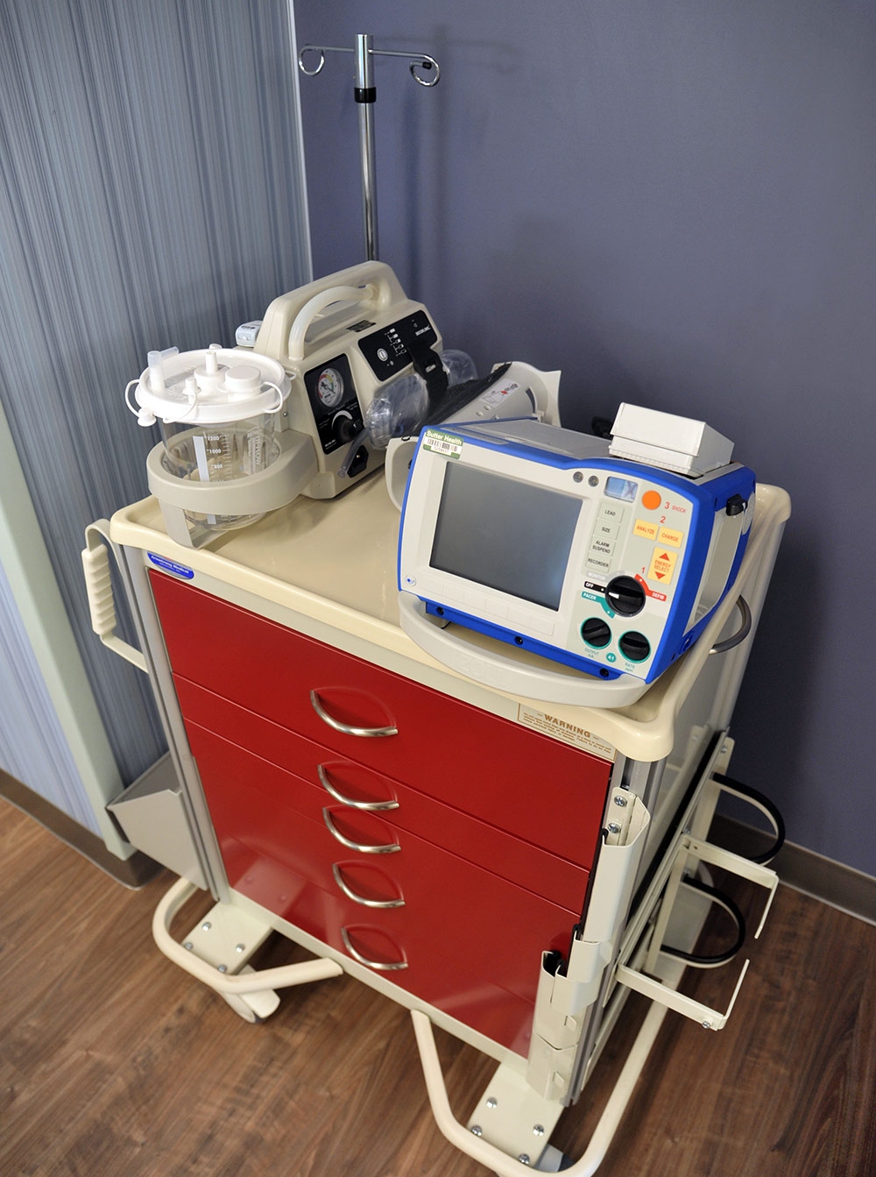
Fire Safety Guidelines
Smoking is prohibited in all buildings and vehicles.
Check cords and equipment.
Know where pull stations and fire extinguishers are located.
Know evacuation routes – stop and look – where are the exit signs?
Never block access to pull stations, fire extinguishers and medical gas value boxes.
Corridors should be clear except for crash carts, isolation carts or “in use equipment.”
As always, report problems to your supervisor if you cannot correct the problem yourself!
Notes:
Smoking is prohibited in all buildings and vehicles.
Check cords and equipment for damage and frayed ends.
Know where pull stations and fire extinguishers are located.
Know evacuation routes – stop and look – where are the exit signs.
As always, report problems to your supervisor if you cannot correct the problem yourself!

Slide 28
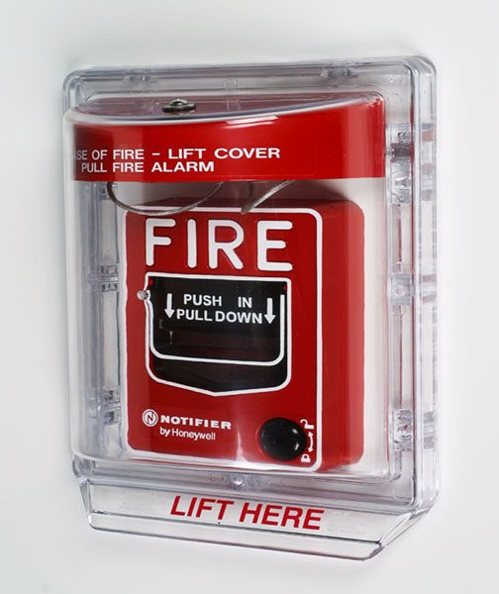
General Fire Safety
If the fire alarm is activated, make sure corridors are clear.
During an actual fire or smoke event, do not use elevators.
Follow exit signs to the nearest, safest exit stairwell.
Do not open doors if they are hot to touch, or if you can see smoke.
If you become trapped in a room, and cannot exit safety, keep the door closed and seal off any cracks. Call hospital operator at 4-4444 and report your exact location.
If a door feels cool to the touch, open it cautiously. Be prepared to slam the door shut if the corridor is full of smoke or if you feel heat when opening the door. If the corridor is clear, proceed with evacuation.
If you are caught in smoke or heat, stay low until you reach a safe area such as another smoke compartment.
Notes:
Never block access to pull stations, fire extinguishers and medical gas value boxes.
If the fire alarm is activated, make sure corridors are clear.
During an actual fire or smoke event, do not use elevators. Follow exit signs to the nearest, safest exit stairwell.
If the corridor is clear, proceed with evacuation.
If you are caught in smoke or heat, stay low until you reach a safe area such another smoke compartment.

Slide 29
Fire Safety – RACE
Rescue
Rescue/Remove person(s) from the immediate danger
Alarm
Activate the nearest fire alarm then call 4-4444
Confine
Confine fire and smoke by closing all doors in the area
Extinguish or Evacuate
Extinguish the fire or Evacuate the area
Notes:
New facility will still use the RACE acronym to Rescue, Alarm, Confine and Extinguish or Evacuate

Slide 30
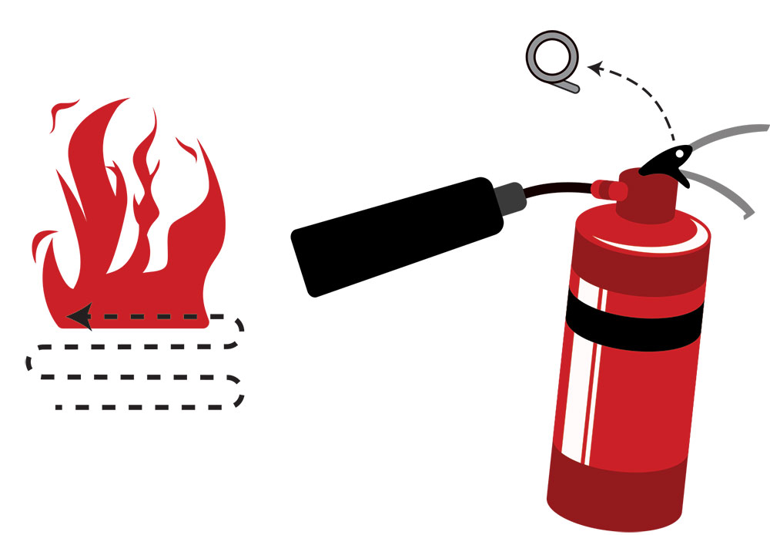
Using a Fire Extinguisher – PASS
Pull: Pull the safety pin on the extinguisher
Aim: Aim the hose at the base of the fire
Squeeze: Squeeze the handle
Sweep: Sweep the hose across the base of the fire from side to side
1
3
2
4
Notes:
New facility will still use the RACE acronym to Rescue, Alarm, Confine and Extinguish or Evacuate

Slide 31
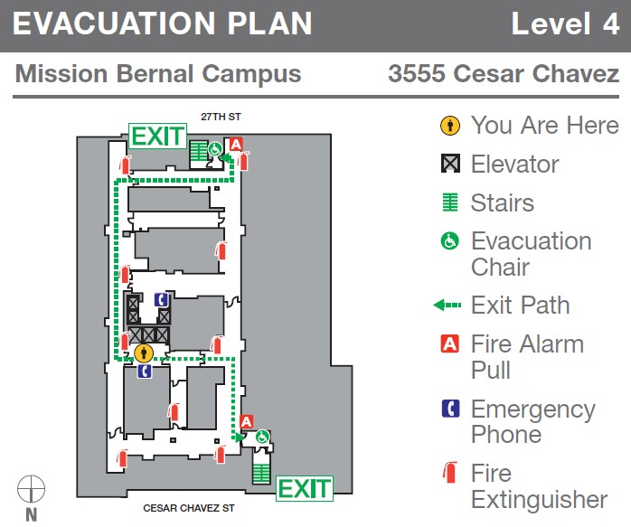

Evacuation Plans
Exit route signage - like the one shown - is posted throughout the building.
Be familiar with the evacuation routes in your department.
Notes:
Be familiar with the evacuation routes in your department. In an emergency, follow the exit route signage posted throughout the building.

Slide 32
Responding to a Code Blue or other medical emergency
If you witness a patient, visitor or staff member who is in cardiac and/or respiratory distress, dial 5-5555 from a hospital phone
For other types of urgent medical situations (Rapid Response) and non-medical emergencies (Code Red, Code Gray, etc.), dial 4-4444 from an in-house phone, provide nature of emergency, your name and location
Crash cart & module exchange process will remain the same
For patient or non-patient emergencies in the Medical Office Building, Pacific Campus (after March 2nd), or California Campus (after March 3rd) call 911

Slide 33
Door alarms and stairwell access
In the event of a fire, all persons in the building must be able to exit via emergency stairwells
We cannot lock interior doors, but we can alarm doors “Authorized Hospital Staff Only, Alarm Will Sound” or “Emergency Exit Only, Alarm Will Sound” to notify security when a person has entered an authorized hospital staff only area
To prevent the alarm from sounding, use your badge on the card reader
Stairwells are EXIT ONLY for the public. To re-enter a floor from the stairwell, staff must badge in
On the Women’s and children’s floors, door signs say “KEEP PUSHING. THIS DOOR WILL OPEN IN 15 SECONDS. ALARM WILL SOUND”
These doors are part of an infant security system
Only certain employees can deactivate the alarm with their badge
In case of fire, continue to push on door and it will open

Slide 34
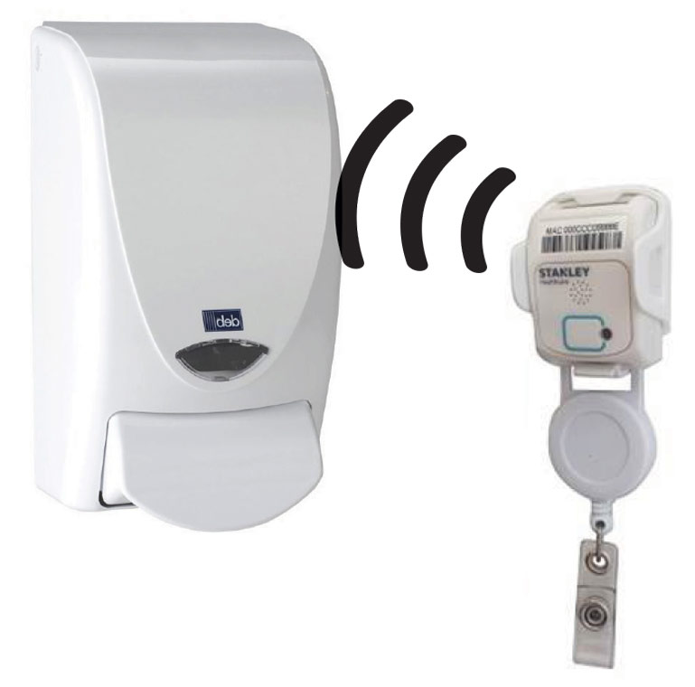
Hand Hygiene
Through our Aeroscout Hand hygiene system, we will be able to monitor and record our hand hygiene events, including number of hand washing and location in patient care areas over Wi-Fi. Hand hygiene benefits:
Enables Infection Control and Process Improvement staff to focus on compliance, education and data analysis
Does not disrupt routine patient care workflows
Provides automated data collection and reporting
Drives accountability down to the caregiver level

Slide 35
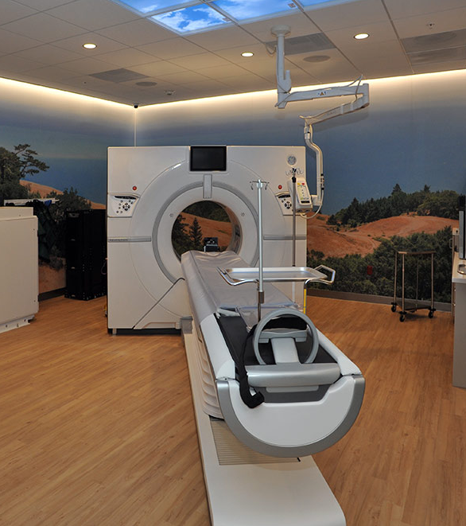
MRI Safety
All equipment to be taken into the scanner room, must be made of non-ferrous material and be classified as MR safe.
MRI Security and Access
Unauthorized access to the MRI Suite and scanner magnet can result in:
injury
damage to personal items
damage to the scanner
EVS has a special designated MRI suite closet with non metallic supplies
Notes:
All equipment to be taken into the scanner room, housekeeping supplies (bucket, broom, mop, etc), research equipment (props), tools, and emergency equipment (fire extinguisher, etc) must be made of non-ferrous material and be classified as MR safe.
Unauthorized access to the MRI Suite and scanner magnet can result in injury to those who may have conditions that are unsafe for the MR environment, damage to personal items that can be affected by the magnetic field, and damage to the scanner resulting from a ferromagnetic object being pulled into the bore of the magnet

Slide 36
Quiz Time
Safety
For fire safety, what do the acronyms RACE and PASS mean?

Slide 37
Quiz Time
Safety
For fire safety, what do the acronyms RACE and PASS mean?
RACE = Rescue, Alarm, Confine and Extinguish or Evacuate
PASS = Pull, Aim, Squeeze, Sweep

Slide 38

Safety in a Disaster
Notes:
At times, our facility, or city and our region may be involved in a significant event. The follow section reviews our guidelines in times of a disaster.

Slide 39
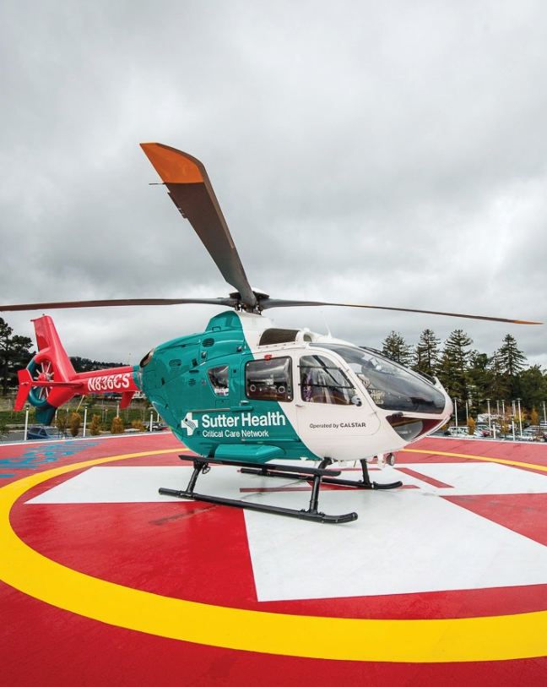
Emergency Management
Emergencies, disasters and other catastrophic events pose a significant threat to the ability of a health care organization to maintain operational capability and provide care, treatment, and services to its community.
CPMC has implemented a comprehensive All-Hazards Emergency Operations Plan to respond to the medical needs of the community in the event of an emergency, disaster situation, or a mass casualty incident.
The All-Hazards Emergency Operations Plan is an organization-wide program that incorporates all services and sites of care under the CPMC license. This plan applies to staff, licensed independent practitioners, contract workers, volunteers and others as appropriate and indicated throughout this document.
Notes:
CPMC has implemented a comprehensive All-Hazards Emergency Operations Plan to respond to the medical needs of the community in the event of an emergency, disaster situation, or a mass casualty incident.
We have an organization-wide program, The All-Hazards Emergency Operations Plan that incorporates all services and sites of care under the CPMC license.

Slide 40
Emergency Management (cont’d)
The All-Hazards Emergency Operations Plan complies with the elements of the National Incident Management System (NIMS), incorporates the Hospital Incident Management System (HICS), and addresses the six critical areas mandated by Joint Commission standards:
Communications
Resources and assets
Safety and security
Staff responsibilities
Utilities management
Patient clinical and support activities
The full plan is located on the CPMC Intranet
Notes:
The All-Hazards Emergency Operations Plan complies with the elements of the National Incident Management System (NIMS), incorporates the Hospital Incident Management System (HICS), and addresses the six critical areas mandated by Joint Commission standards:
Communications
Resources and assets
Safety and security
Staff responsibilities
Utilities management
Patient clinical and support activities
The full plan is located on the CPMC Intranet

Slide 41

Communications in a Disaster
Sutter Health affiliates use Everbridge Mass Notification System to communicate to all staff simultaneously in an emergency. The system-wide notification system enables CPMC staff to receive and respond to critical safety and business impact information in a timely manner.
Everbridge allows CPMC to communicate with staff via multiple contact paths including home phone, email, mobile phones and other communication devices during an emergency event.
Notes:
Sutter Health affiliates use Everbridge Mass Notification System to communicate to all staff simultaneously in an emergency enabling CPMC staff to receive and respond to critical safety and business impact information in a timely manner.

Slide 42
Communications in a Disaster
What to do when a notification is received:
Read (when received via email) or listen to the message carefully for directions
“Confirm the Message” so CPMC knows you have received it
Having accurate contact information in Lawson is critical as it is the source of contact information for Everbridge
How to update your personal contact information:
Check the Lawson e-Self Service site on the Intranet Portal to confirm your personal contact information is correct.
Please direct questions regarding Everbridge to the Safety Department at 415-600-4620 or email sforzok@sutterhealth.org.
Notes:
What to do when a notification is received:
Read or listen to the message carefully for directions
“Confirm the Message” so CPMC knows you have received it
Having accurate contact information in Lawson is critical as it is the source of contact information
How to update your personal contact information:
Check the Lawson e-Self Service site on the Intranet Portal to confirm your personal contact information is correct.
Please direct questions regarding Everbridge to the Safety Department at 415-600-4620 or email sforzok@sutterhealth.org.

Slide 43
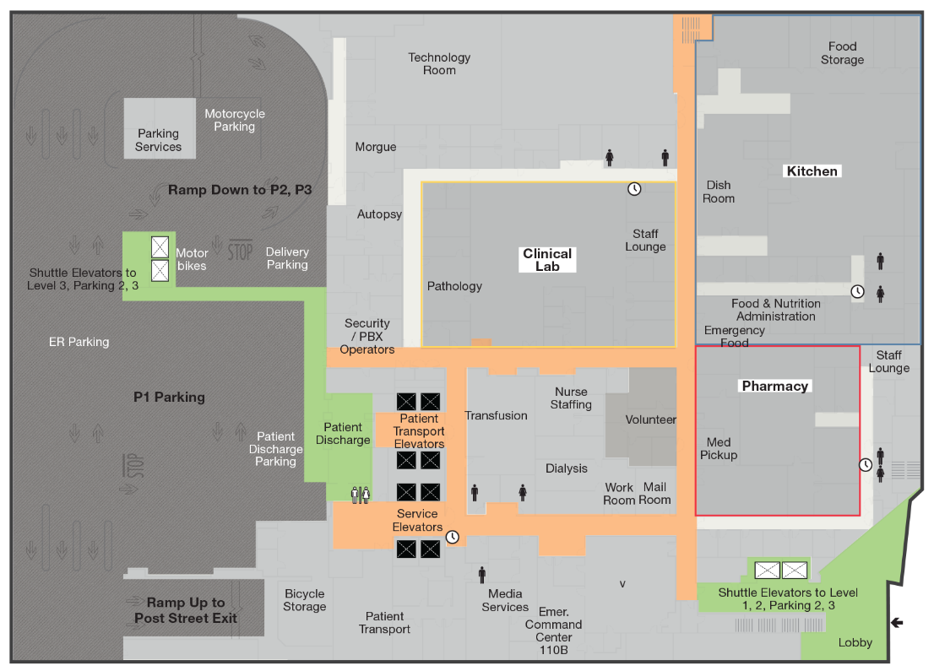
Hospital Command Center
The hospital uses the Hospital Incident Command Structure (HICS) to manage emergency events and if the situation warrants the Emergency Operations Plan would be activated via Code Triage.
If Code Triage is initiated, the Hospital Command Center (HCC) will be activated and is located on the first floor. If additional resources are needed to manage the event, the Labor Pool will be activated and is located in the hospital cafeteria.
Hospital Command Center
Notes:
The hospital uses the Hospital Incident Command Structure (HICS) to manage emergency events. If Code Triage is initiated, the Hospital Command Center (HCC) will be activated

Slide 44
Quiz Time
Safety in a disaster
What communication system is engaged to reach staff during a disaster?

Slide 45
Quiz Time
Safety in a disaster
What communication system is engaged to reach staff during a disaster?
The Everbridge System

Slide 46
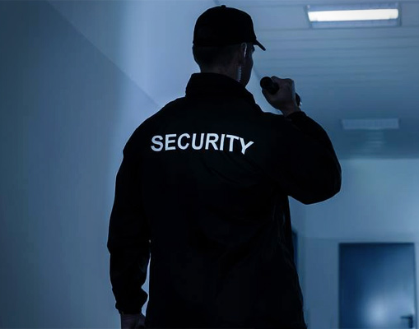
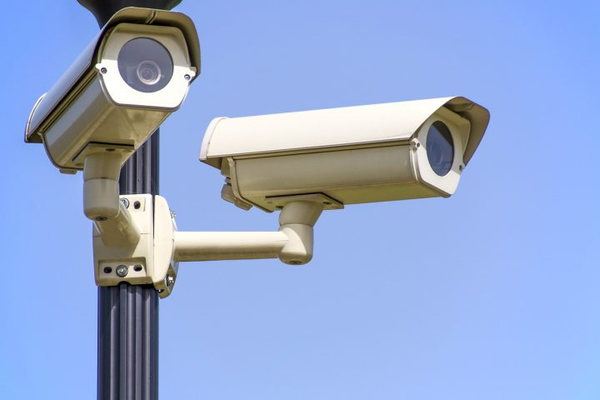
Security
Notes:
We want all employees, patients and visitors to be safe in the new MBC facility. Important safety information is included in this section

Slide 47
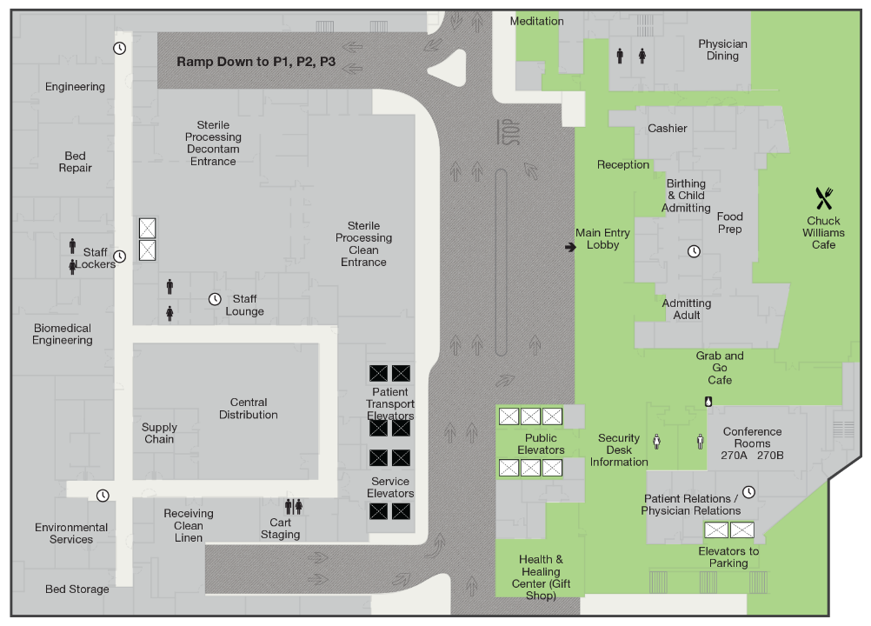
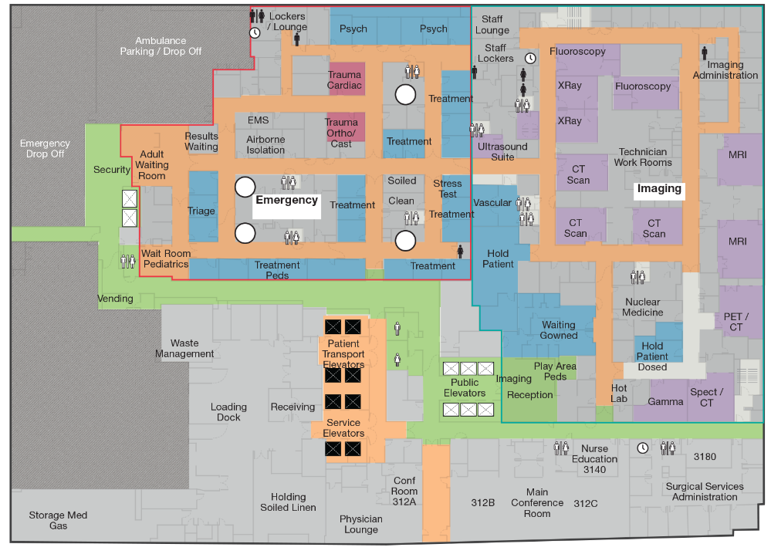
Safety and Security
Security Stations for the Van Ness Campus are located:
2nd floor main lobby
3rd floor emergency room
Security Enhancements include:
A metal detector at the ED entrance
Panic alarms at high risk areas with silent alarm sent to Security Dispatch
Security stations at key main entrances including the ED, loading dock, and drive through
Staff Duress buttons on Aeroscout RFID tags worn by staff
HUGS Infant Security and patient elopement
Security Desk
2nd Floor
Security Desk
3rd Floor
Notes:
Security enhancements include:
A metal detector at the ED entrance
Panic alarms at high risk areas with silent alarm sent to Security Dispatch
Security stations at key main entrances
Staff Duress buttons on Aeroscout RFID tags worn by staff
Contact Security Dispatch x60837 for escort or general security concerns

Slide 48
Security Awareness
Help Us Help You
Wear your hospital badge
Be aware of your surroundings
If you see something, say something
Dial 4-4444 for non-Code Blue emergency situations
Keep your personal property locked and secure
Pay attention to anyone who acts suspiciously or like they don’t belong
Make sure vendors have a vendor badge
Contact Security Dispatch x60837 for escort or general security concerns
Notes:
Wear your hospital badge
Be aware of your surroundings
If you see something – say something
Dial 4-4444 for non-Code Blue emergency situations
Keep your personal property locked and secure
Pay attention to anyone who acts suspiciously or like they don’t belong
Make sure vendors have a vendor badge
Contact Security Dispatch x60837 for escort or general security concerns

Slide 49
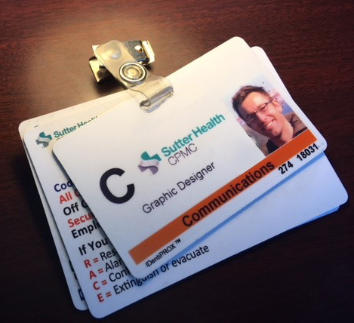
Personal Identification Badge
Badge must be worn at all times, many doors will require badge reader to upon entry
Do not let anyone use your badge
Registry staff will be required to show registry ID before being issued a badge. These need to be return to charge nurse end of shift
Ensure no one enters behind you when badging in
If you forgot your badge, please go to the Security Office on the first floor for a temporary badge
Notes:
Wear your hospital badge
Be aware of your surroundings
If you see something – say something
Dial 4-4444 for non-Code Blue emergency situations
Keep your personal property locked and secure
Pay attention to anyone who acts suspiciously or like they don’t belong
Make sure vendors have a vendor badge
Contact Security Dispatch x60837 for escort or general security concerns

Slide 50
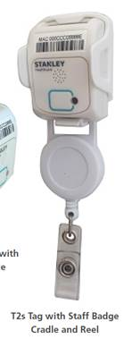
Security Response to Staff Duress
Call Security Dispatch (x60837) to provide details of the situation, so that Security can arrive on the scene prepared – this is the preferred method
If unable to call Security, the staff can press the staff duress button on the Aeroscout RFID tag (when activated, the button will light up)
Security button on headwall can also be used (alarms to PBX and then to Security)
Notes:
Call Security Dispatch (x60837) to provide details of the situation, so that Security can arrive on the scene prepared – this is the preferred method
If unable to call Security, the staff can press the staff duress button on the Aeroscout RFID tag (when activated, the button will light up)
Security button on headwall can also be used (alarms to PBX and then to Security)

Slide 51
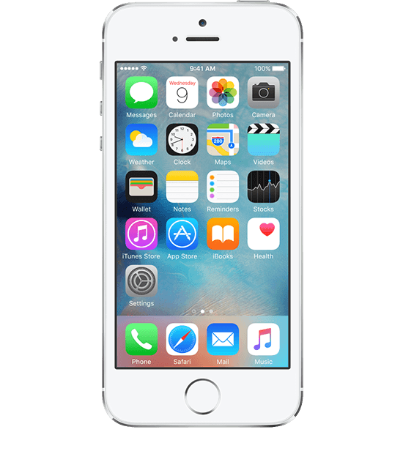

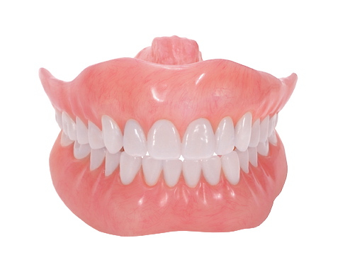
Patient Belongings, Valuables, and Lost and Found
For patient lost and found items, please direct them to Security or contact Patient Relations at 415-600-3280
Lost and found is located in the security office on the 1st floor. Please contact Security at 415-600-0837 if you have a missing item that cannot be located
Notes:
Patient belongings are stored in a room near the ED Security desk
Patient Valuables are stored in the admitting / cashier area
For patient lost and found items, please direct them to Security Patient Relations

Slide 52
Secured Document Containers
Confidential document containers are located throughout the hospital. These are emptied every two weeks by the shredding company.
If a bin needs emptying prior to a regularly scheduled pick up, call the Support Center (x67900) to arrange for EVS to empty it.
Van Ness Campus is dedicated to being a green facility, however, so please remember to THINK BEFORE YOU INK.
Notes:
Confidential document containers are located throughout the hospital. These are emptied every two weeks by the shredding company.
Van Ness is dedicated to being a green facility, however, so please remember to THINK BEFORE YOU INK.

Slide 53
Quiz Time
Security
What new technology feature will be distributed to staff to use during a duress situation?

Slide 54
Quiz Time
Security
What new technology feature will be distributed to staff to use during a duress situation?
A staff duress Aeroscout RFID tag

Slide 55
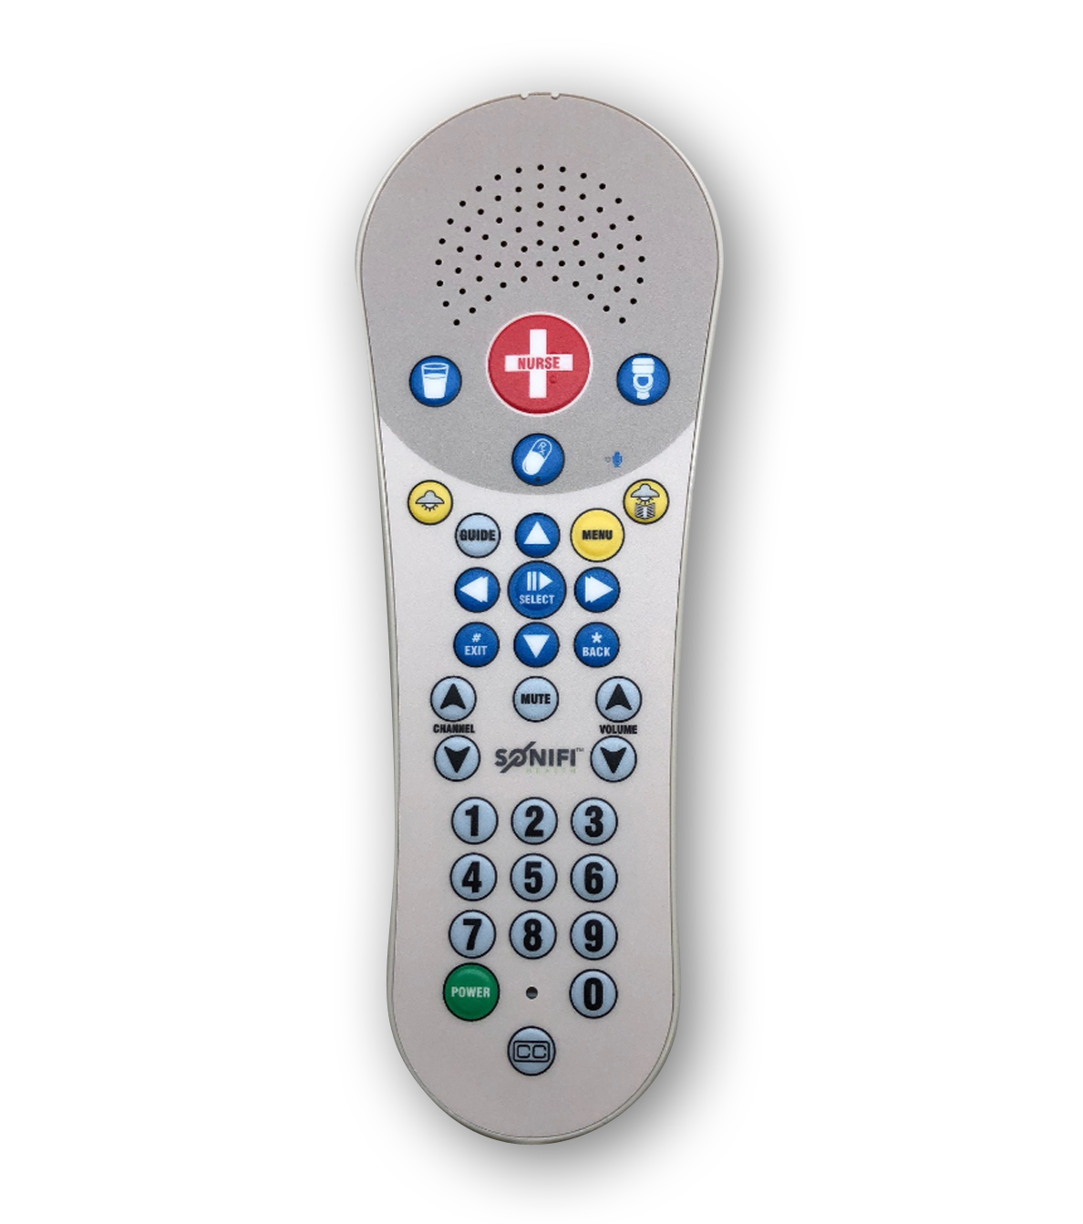
Communications
Notes:
We want all employees, patients and visitors to be safe in the new MBC facility. Important safety information is included in this section

Slide 56
Patient Communications (Sonifi)
DirectTV programs and controls
View Assigned Educational Content
Order patient meals
View care team information
Access patient schedule
Controls and Volume Integrated Into Pillow Speaker
Notes:
Sonifi is an integrated communication and entertainment system used in the patient room to program the television, review educational materials, and order meals along with several other features. It allows:
DirectTV programming and controls
Viewing Assigned Educational Content
Ordering meals
Viewing care team information
Accessing the patient schedule
Interacting with the care team
Integration with nurse call Pillow Speaker for volume and controls

Slide 57
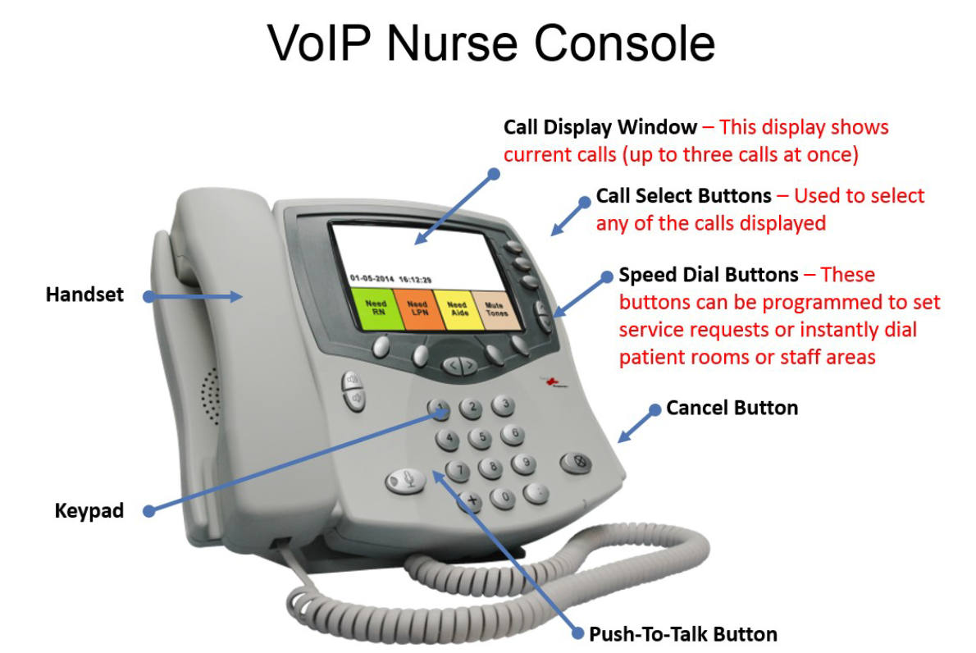
Nurse Call Systems – Rauland Responder 5
Every patient care unit has a nurse call system. The system consist of a nurse console, patient room headwall unit, patient handset, shower and toilet pull cords, and dome lights located outside the patient room.
Serves as a code required system for patient safety & security
Provides a patient alert-communication system for hospital staff
Integrates with other applications such as Vocera and Sonifi in order to produce hospital-wide communications and notifications
Notes:
Every patient care unit has a nurse call system. The system consist of a nurse console, patient room headwall unit, patient handset, shower and toilet pull cords, and dome lights located outside the patient room.
Serves as a code required system for patient safety & security
Provides a patient alert-communication system for hospital staff
Integrates with other applications such as Vocera and Sonifi in order to produce hospital-wide communications and notifications

Slide 58
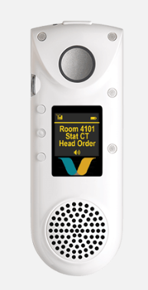
Vocera Communications
The Vocera badge delivers hands-free, real-time voice communication between the wearer, patients and other staff members
This communication system weighs less than two ounces, allowing users to keep their hands free
Vocera is integrated at Responder 5 Nurse Call, Cisco IP phones and Philips monitors at the new VNC facility
Notes:
The Vocera badge delivers hands-free, real-time voice communication between the wearer, patients and other staff members
This communication system weighs less than two ounces, allowing users to keep their hands free
Vocera is integrated at Responder 5 Nurse Call, Cisco IP phones and Philips monitors at the new MBC facility

Slide 59
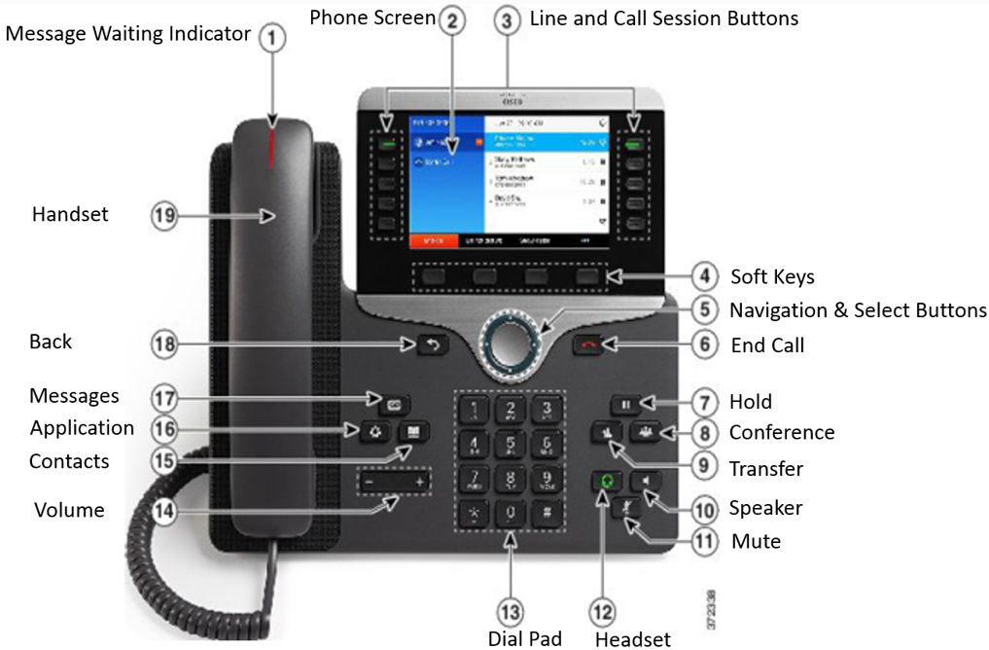
Telephone System – Cisco VoIP
Cisco Voice over IP (VoIP) Connects to the Vocera application so that calls can be make between telephones and Vocera badges.
Informacast for paging and broadcast messaging
Emergency red phones will be installed in key locations
We will be using the Microsoft Outlook Address Book as the employee phone directory for all CPMC Campuses.
Notes:
Cisco Voice over IP (VoIP) Connects to the Vocera application so that calls can be make between telephones and Vocera badges.
Informacast for paging and broadcast messaging
Emergency red phones will be installed in key locations
We will be using the Microsoft Outlook Address Book as the employee phone directory for all CPMC Campuses.

Slide 60
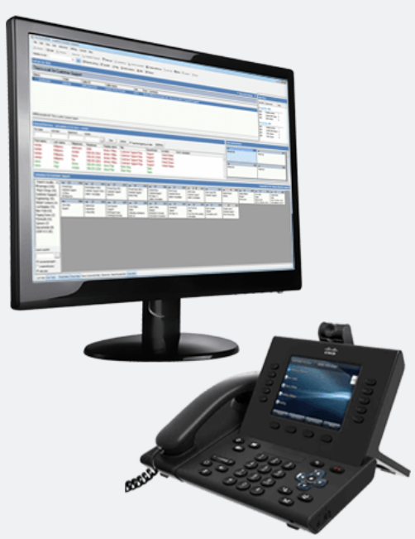
Communication Operations and Systems
Communication Operators will be located at the Van Ness Campus.
Communication Operators will have Nurse Call and other alarm panels to assist in routing alerts.

Slide 61
Digital Signage
All nurse stations will have digital display boards to display patient census
Specialized display boards will also be present in the ORs and Emergency Department
Conference rooms will have digital signs indicating the daily schedule
A digital donor wall will be present in the lobby areas
Electronic informational kiosks will be located at main patient entrances to facilitate wayfinding
The cafeteria will have digital signs displaying the daily menu
Notes:
There are multiple digital displays throughout the new MBC facility to improve communication.
All nurse stations will have digital display boards to display patient census
Specialized display boards will also be present in the ORs and Emergency Department
Conference rooms will have digital signs indicating the daily schedule
A digital donor wall will be present in the lobby areas
Electronic informational kiosks will be located at main patient entrances to facilitate wayfinding
The cafeteria will have digital signs displaying the daily menu

Slide 62
Quiz Time
Communications
What is the new hands-free communication device that most staff will wear while at VNC?

Slide 63
Quiz Time
Communications
What is the new hands-free communication device that most staff will wear while at VNC?
Vocera hands-free communicator

Slide 64

New Ways to Work
Notes:
Some process changes are to be expected when moving into a new facility. Here are a few highlights. Departments will provide more details as appropriate.

Slide 65
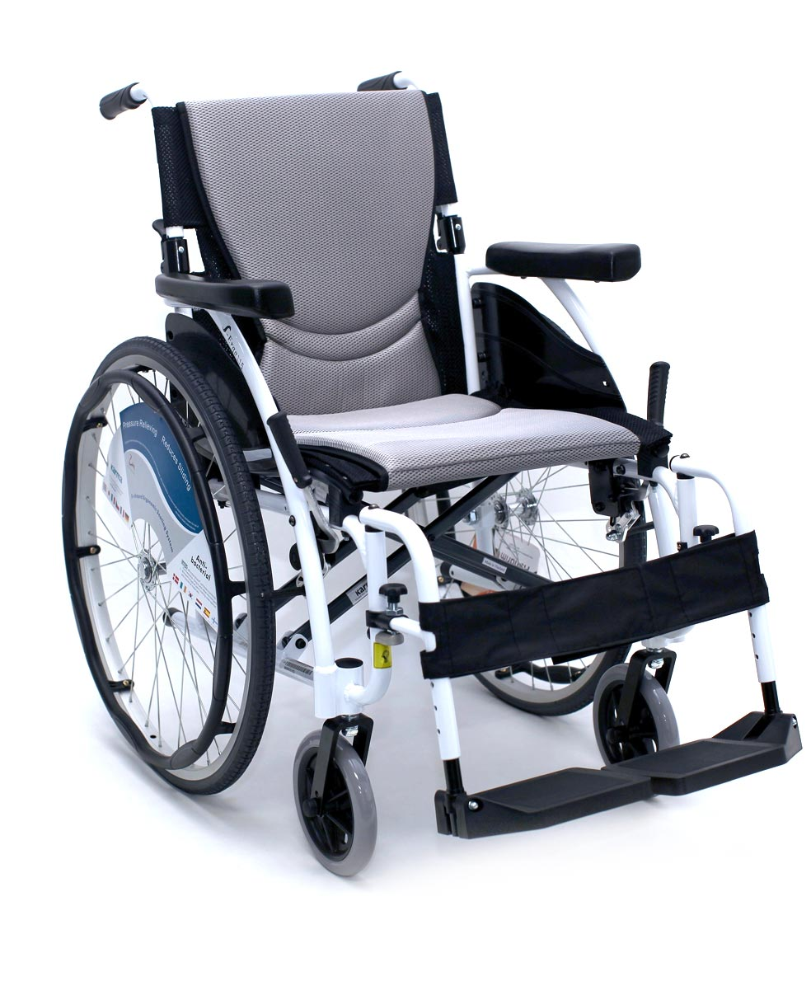
Equipment Tracking with AeroScout RFID Tags
AeroScout Equipment Tracking is used to help locate and service mobile equipment throughout the facility. The equipment is tracked via an RFID tag affixed to the equipment.
Staff will be able to log into the system and search for equipment using various keywords such as description or tag number
Types of equipment to be tagged include things like:
Beds
Wheelchairs
Pumps
Monitors
Ventilators
Various portable devices
Others
Notes:
AeroScout Equipment Tracking is used to help locate and service mobile equipment throughout the facility. The equipment is tracked via an RFID tag affixed to the equipment.
Staff will be able to log into the system and search for equipment using various keywords such as description or tag number
Types of equipment to be tagged include things like:
Beds
Wheelchairs
Pumps
Monitors
Ventilators
Various portable devices
Others

Slide 66
Deliveries and Mail
Supply Chain
Central distribution is located on the 2nd floor Room 2200
Entry at the loading dock and receiving office room 1400 on level P1
The P1 receiving area will be for Fed-Ex, UPS, florist, Lab carriers, Blood Bank, Pharmaceuticals etc.
Central Distribution will operate 7 days a week on 3 shifts 0700-1530, 1500-2330, 0100-0930
For supplies needed between 2330-0100, contact nursing supervisor who has access to Room 2200

Slide 67
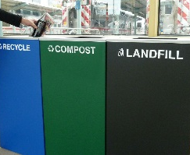
Sustainable Waste Removal
The campus is Leadership in Energy and Environmental Design (LEED) certified
This includes recycling, composting, red-bag (biohazard), pharmaceutical and toxic waste management and medical equipment reuse.
Waste will be separated into streams allowing patients, visitors and staff to contribute to our creating a healthy planet
There are receptacles for three waste streams co-mingled recycling (blue), regular trash (black), and composting (green).
Notes:
Van Ness is designed to be a green hospital. This includes recycling, composting, red-bag (biohazard), pharmaceutical and toxic waste management and medical equipment reuse.
Waste will be separated into streams allowing patients, visitors and staff to contribute to our creating a healthy planet
There are receptacles for three waste streams co-mingled recycling(blue), regular trash (black), and composting (green).

Slide 68
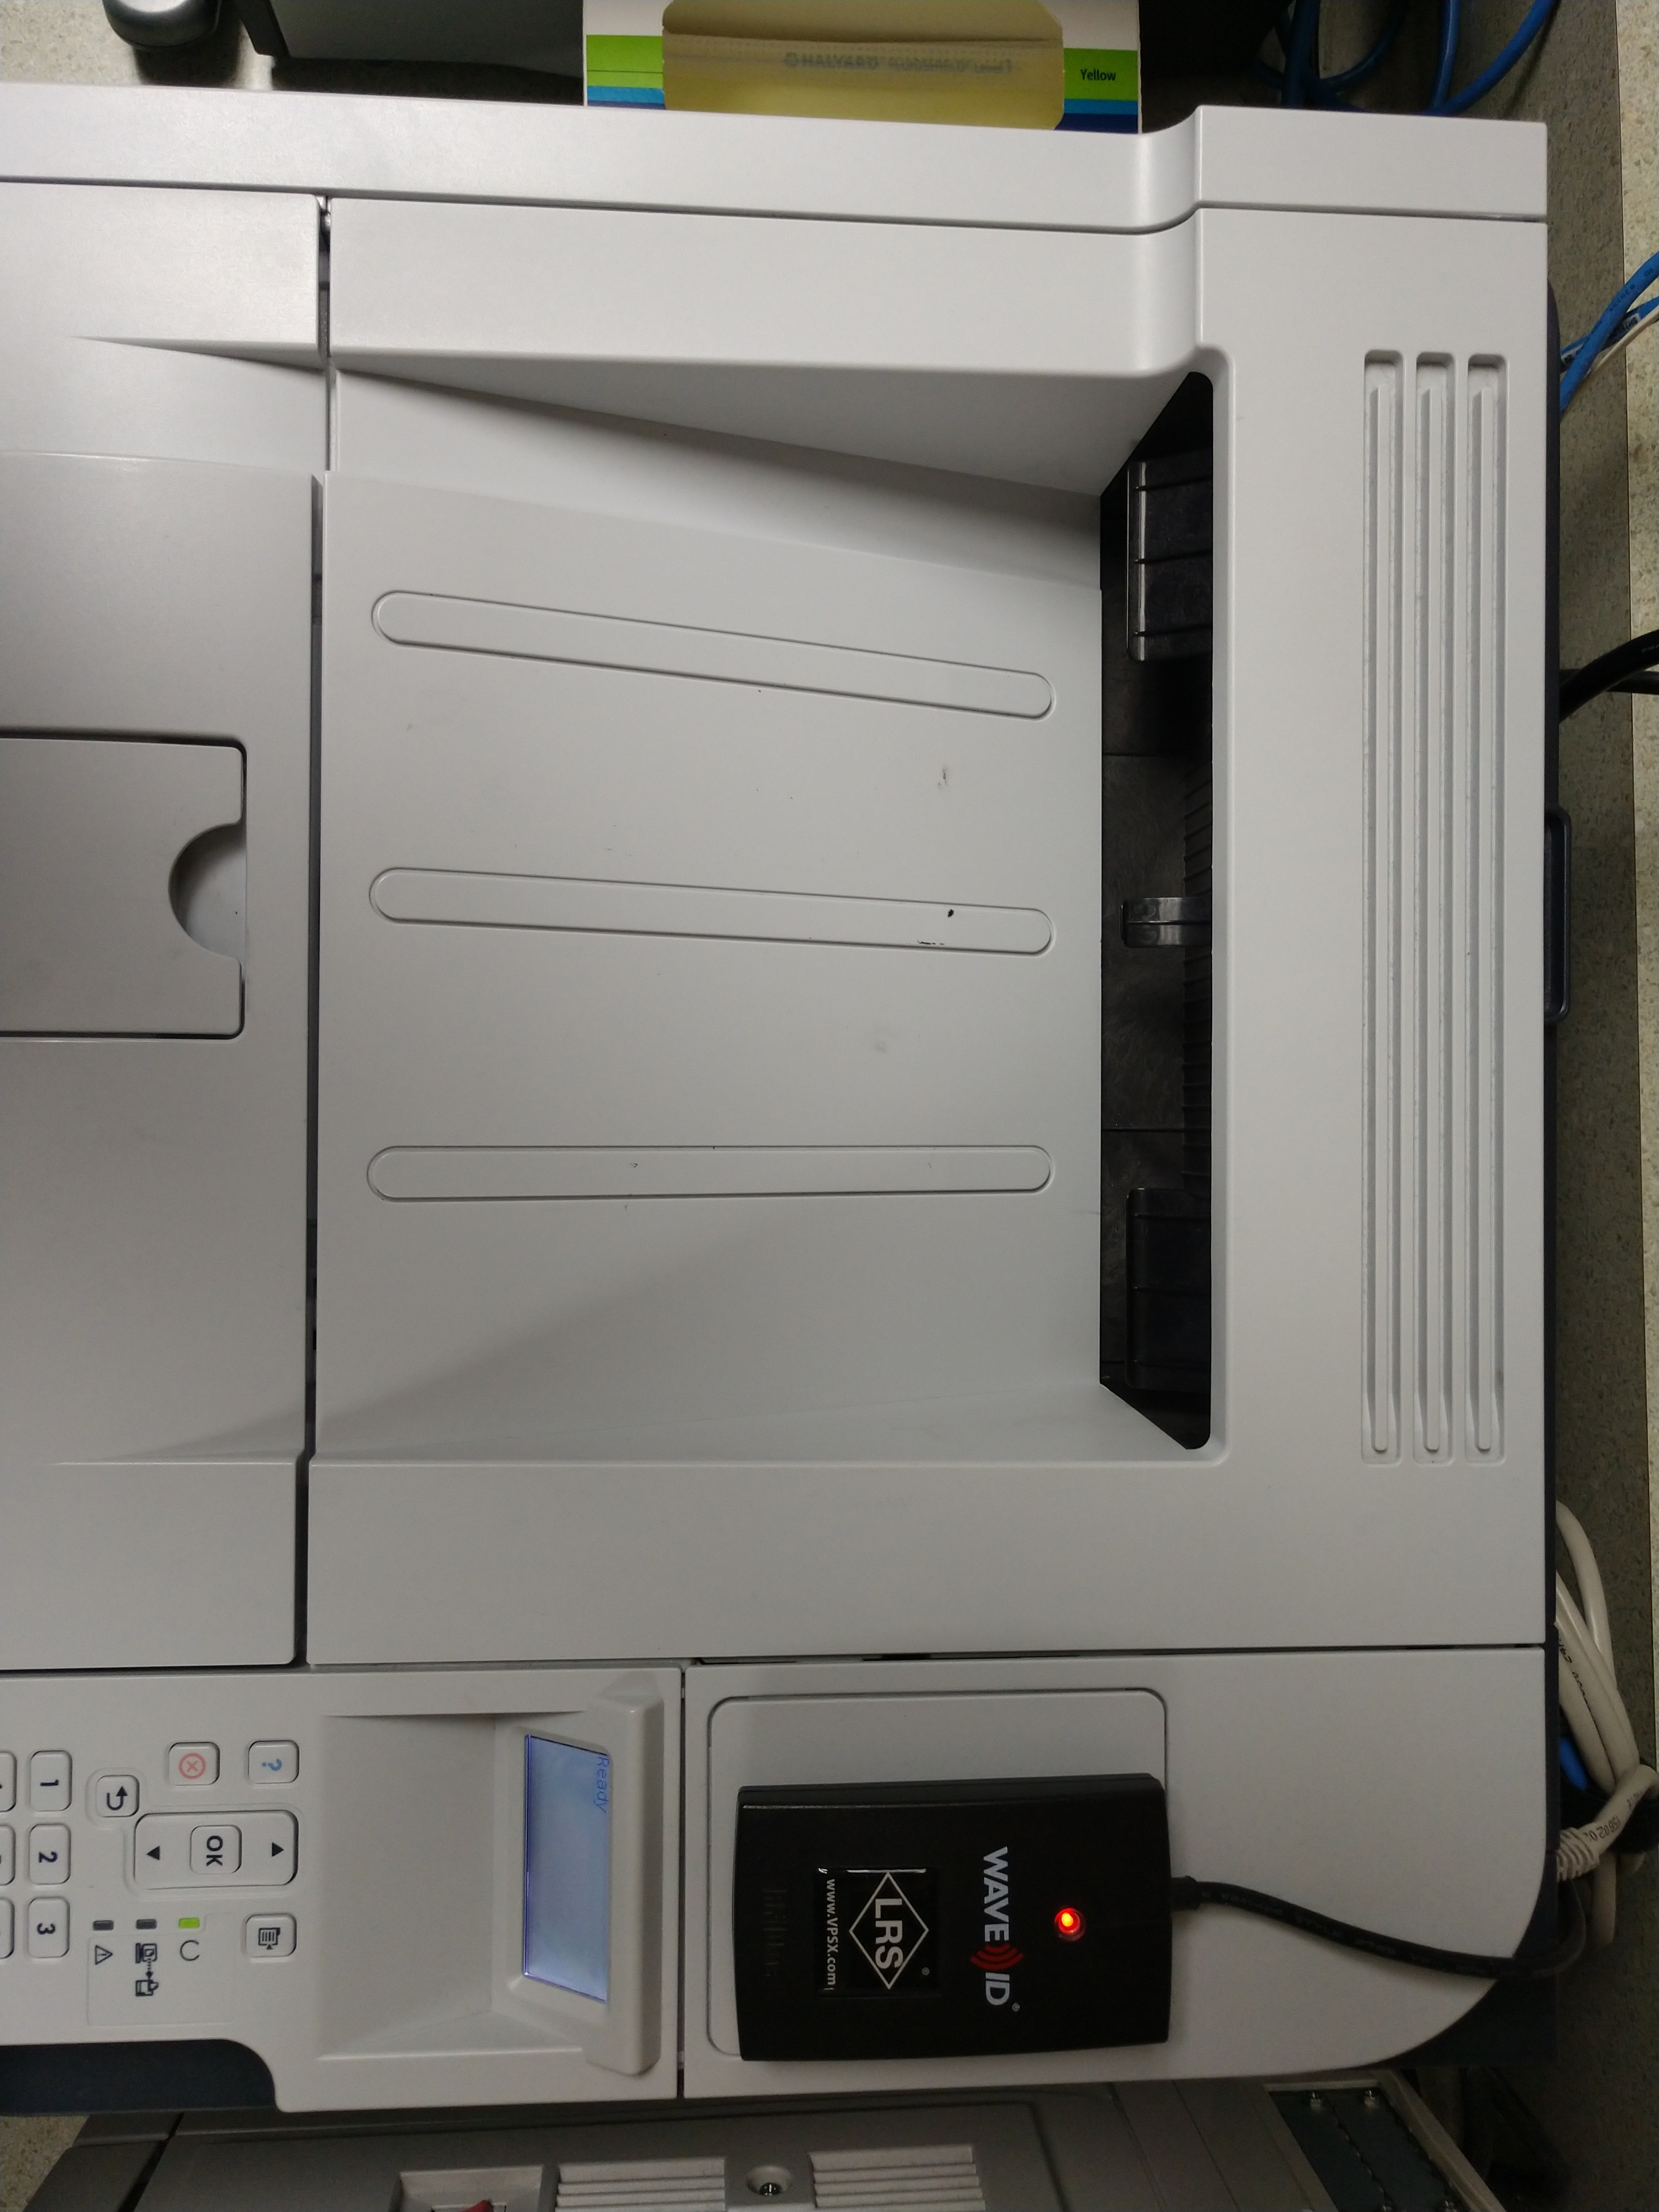
Follow Me Printing (FMP)
FMP sends documents to a virtual print queue in the cloud linked to the user who initiated the print job:
The user can go to any printer, tap their badge tap on the badge reader, and any pending print jobs will print to that printer.
The deployment of FMP is specific to a workstation (not a user, or a printer) and can be customized to accommodate workflows.
Specific print jobs (i.e. RX and some orders) can also remain non-FMP but will need to be assessed and approved by hospital leadership
Copier and printer support is provided by the Sutter Health Service Desk which is accessed by calling 888-888-6044 or accessing the IS Portal at IS.SUTTERHEALTH.ORG.
Badge Reader
Notes:
FMP sends documents to a virtual print queue in the cloud linked to the user who initiated the print job.
The user can go to any printer, tap their badge tap on the badge reader, and any pending print jobs will print to that printer.
The deployment of FMP is specific to a workstation (not a user, or a printer) and can be customized to accommodate workflows.
Specific print jobs (i.e. RX and some orders) can also remain non-FMP but will need to be assessed and approved by hospital leadership
Copier and printer support is provided by the Sutter Health Service Desk which is accessed by calling 888-888-6044 or accessing the IS Portal at IS.SUTTERHEALTH.ORG.

Slide 69
Quiz Time
New Ways to Work
How do I get my printout from Follow Me Printing?

Slide 70
Quiz Time
New Ways to Work
How do I get my printout from Follow Me Printing?
Tap badge to printer
Badge Reader

Slide 71
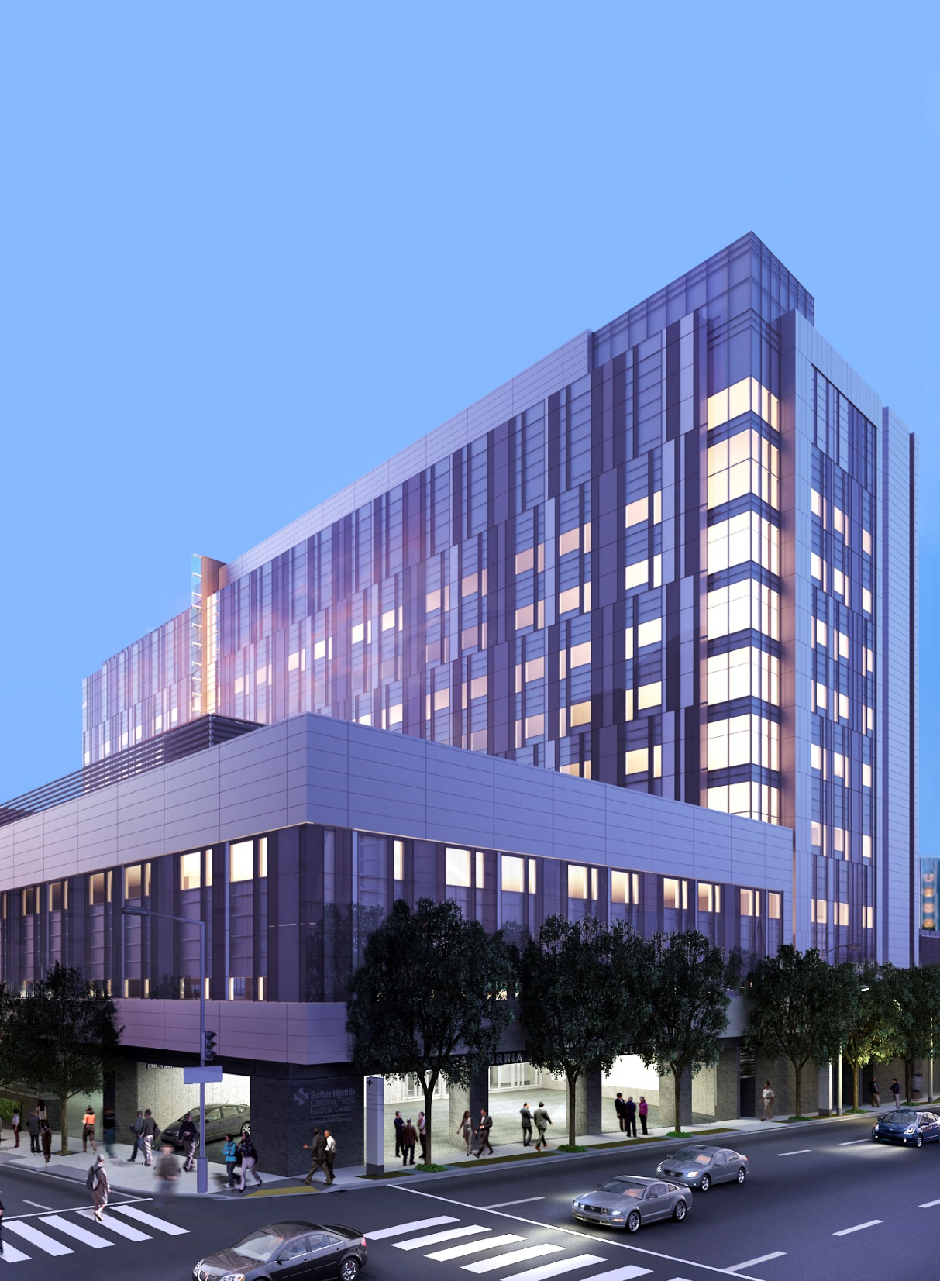
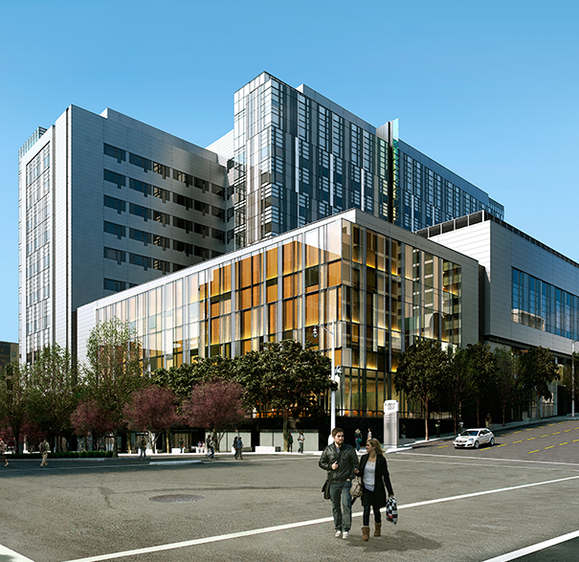
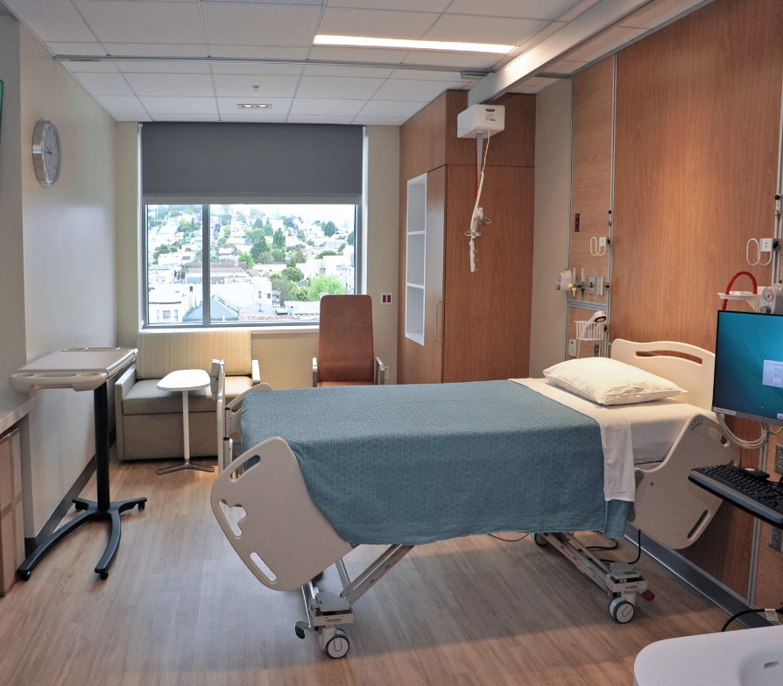
Thank you.
Now let’s tour the new hospital.
During tour, STAY IN GROUP – no wandering!
Please keep conversations to a minimum so you can hear the tour guide.
ENJOY your new spaces!
Notes:
Kelly – Keep an ear out for positive comments, the communications team was looking for news to share.

